Slide 1
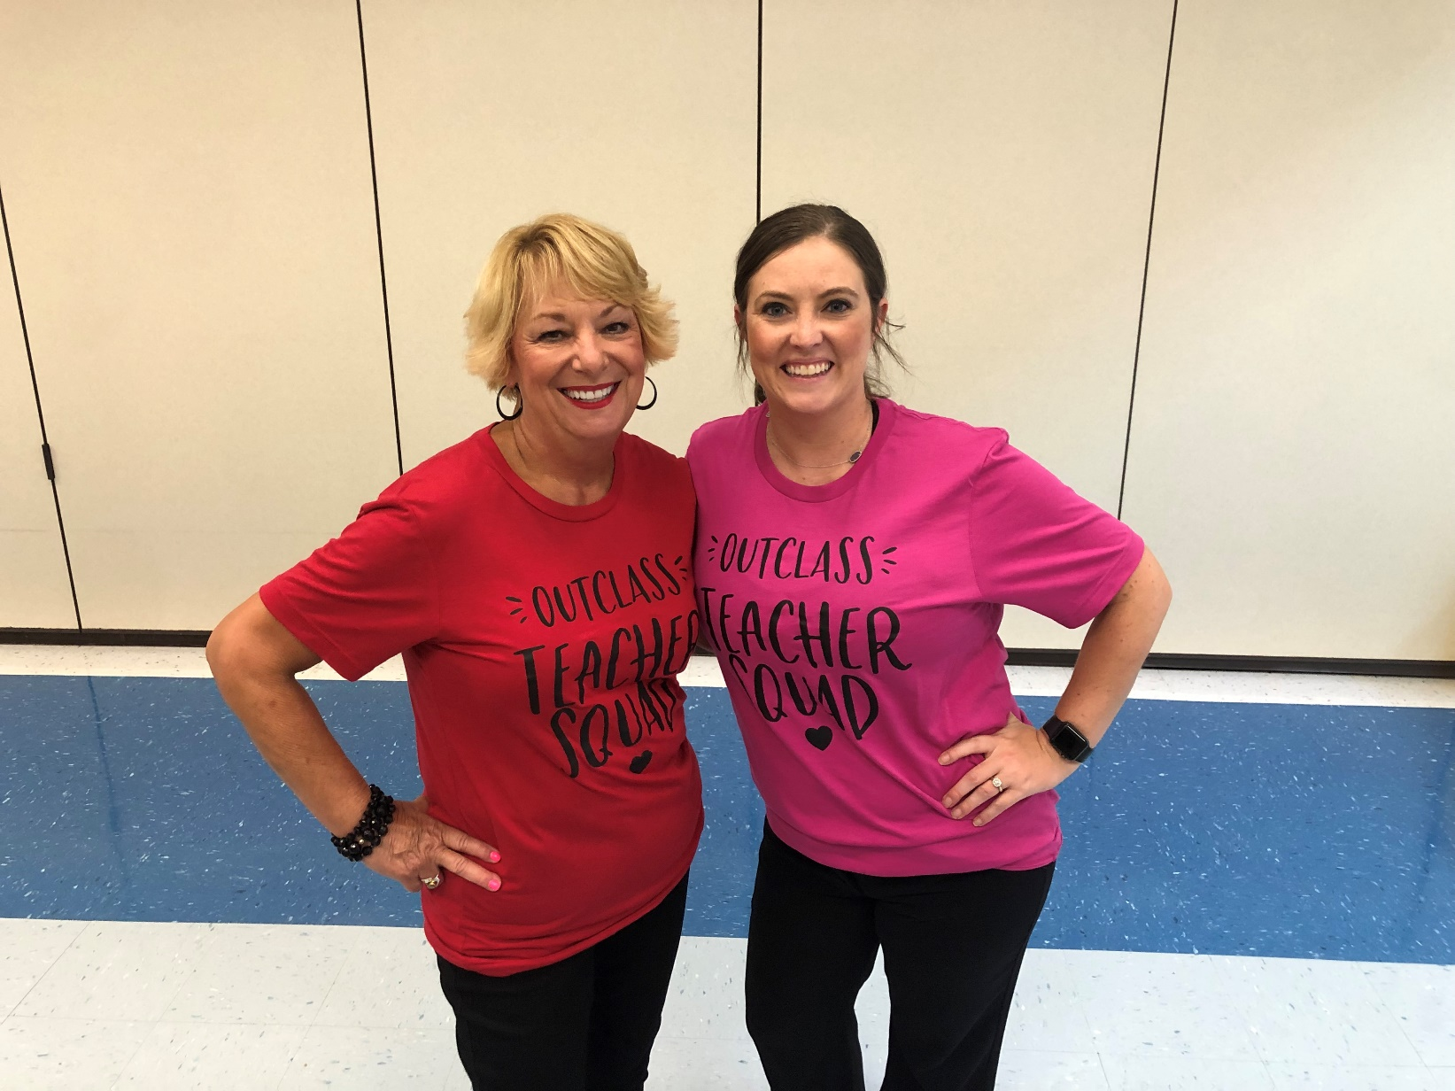
Welcome to PE with Coach Trevino and Coach Blumrick!

Slide 2
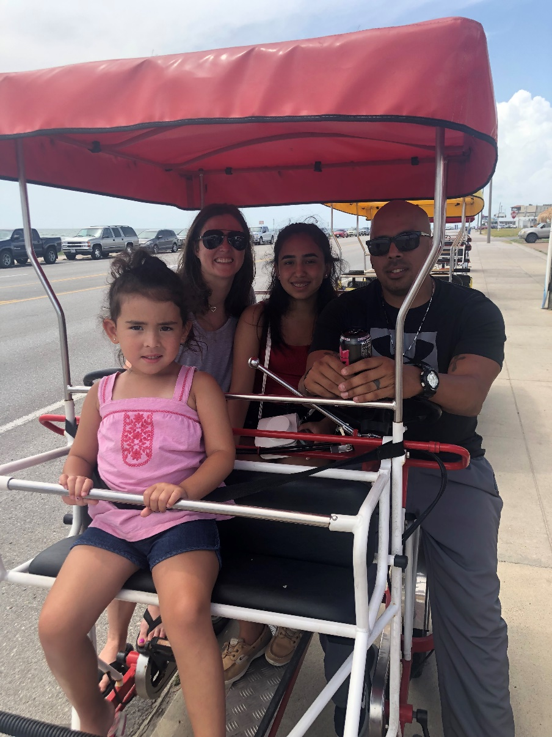
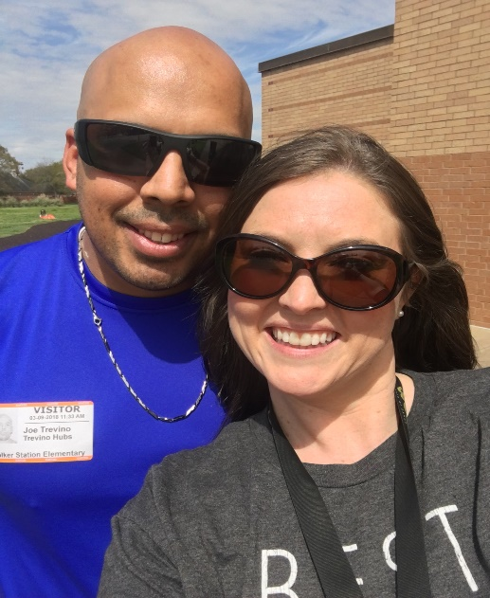
Get to know Coach Trevino
Third year coaching PE
My family
Things I love

Slide 3
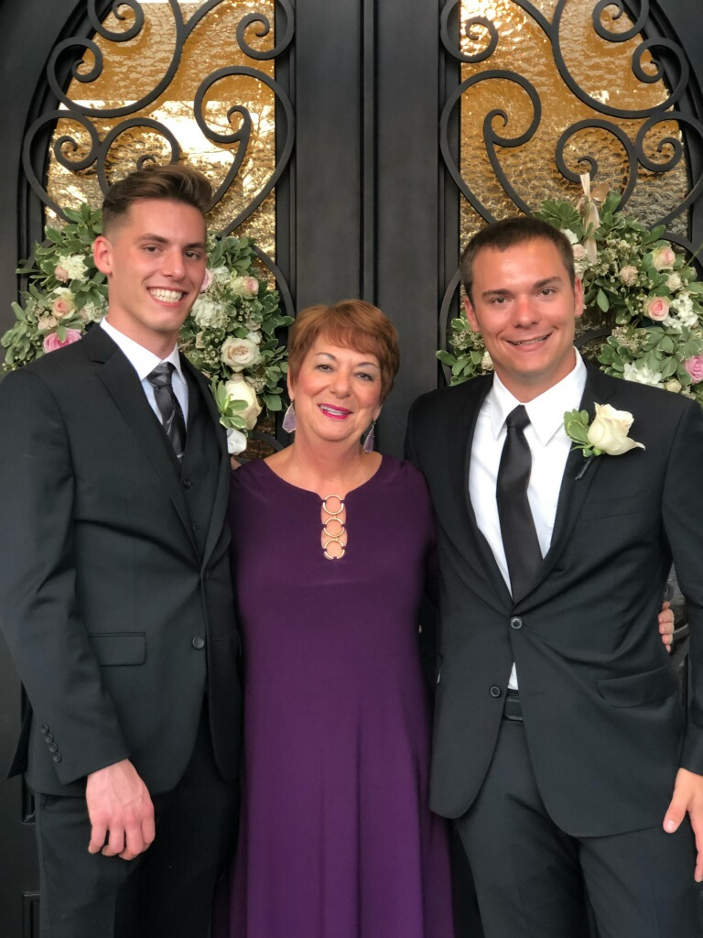
Get to know Coach Blumrick
Tenth year coaching PE; 17 years at WSE
My family
Things I love

Slide 4
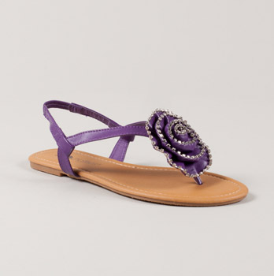
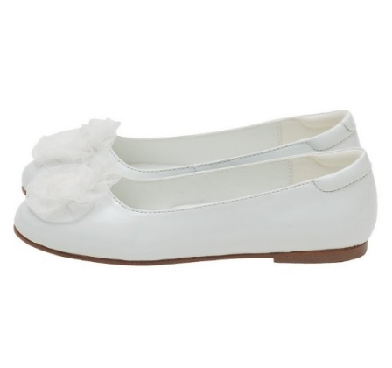
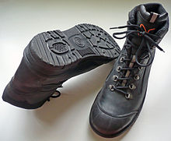
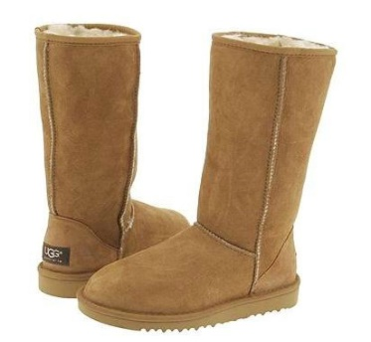
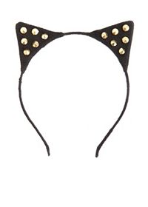
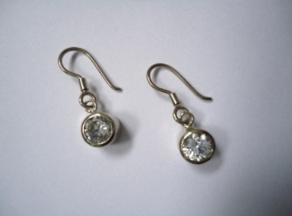
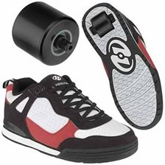
What to wear to PE/What not to wear to PE
Yes No
This show is OK to wear to PE because:
It has shoe laces
Toes are covered
There is a back to the shoe
Foot is completed enclosed
Rubber sole

Slide 5
Doctor’s Notes
Major illness/injuries→ Your parents will need to provide a note from your doctor if you need to be excused for more that three PE classes.
Minor illness/injuries→ Your parents may write a note to excuse you for up to three PE classes.

Slide 6
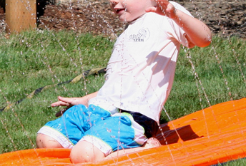
Safety
No spinning on your spot
No sliding across the floor on your knees

Slide 7
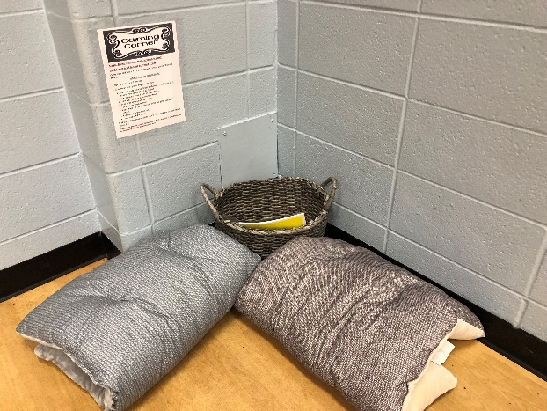
Calming Corner
Come here and take a 1-3 minute break to remove
yourself from the situation.
What to do in the calming corner:
1. Set the timer for 1-3 minutes.
2. Choose an appropriate way to calm down:
I can take deep breaths: Smell the flower (1,2,3,4). Hold (1,2). Blow out the candle (1,2,3,4). Repeat.
I can close my eyes & think of happy times.
I can read, color, or even count by two’s.
I can write about what I am feeling.
I can use the fidget spinner.
I can shake the calming jar and watch the glitter settle to the bottom.
I can squeeze the stress ball.
I can play with the bop-it.
3. When the timer goes off, clean up, come back and join us for some fitness fun!
***Remember that the calm down corner is NOT a time-out or punishment, but an opportunity to take a break and calm down.

Slide 8
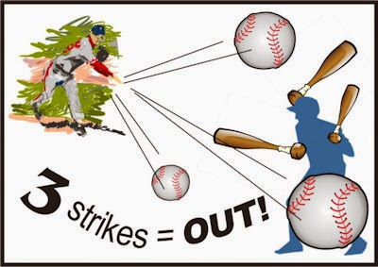
3 STRIKES YOU’RE OUT (2-5 grade)
1st Warning: Friendly reminder
2nd Warning: Teacher initiated trip to
Calming Corner (1:00-3:00 minutes).
3rd Warning: Break time + Fill out THINK SHEET
to take home to parents. (an email will be sent out to parents to notify you that a think sheet is coming home)
3 think sheets in one grading period will result in an N for that grading period.

Slide 9
4 STRIKES YOU’RE OUT (K-1 grade)
1st Warning: Friendly reminder/ Review CHAMPS expectations for activity
2nd Warning: Friendly reminder/ review CHAMPS expectations for activity
3rd Warning: Teacher initiated trip to
Calming Corner (1:00-3:00 minutes).
4th Warning: Break time + Fill out THINK SHEET
to take home to parents (an email will be sent out to parents to notify you that a think sheet is coming home)
***4 think sheets, in one grading period, will result in an N for that grading period.

Slide 10
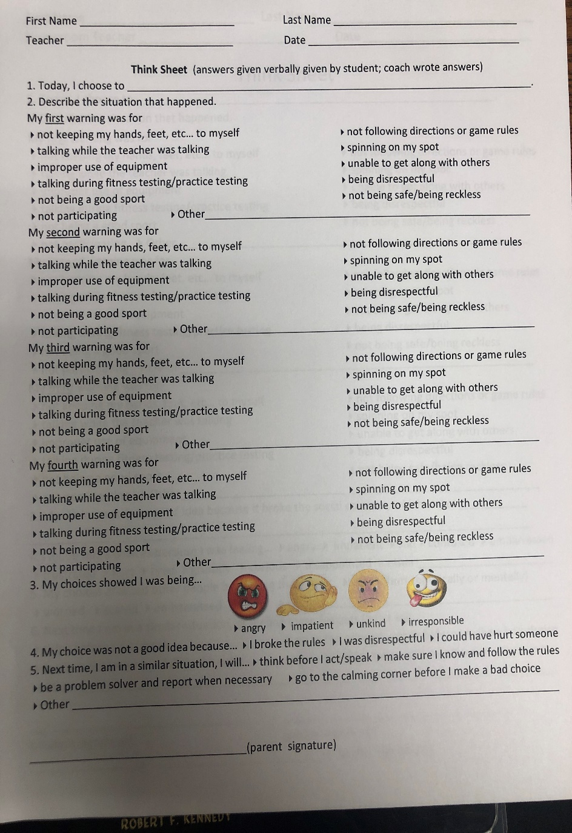
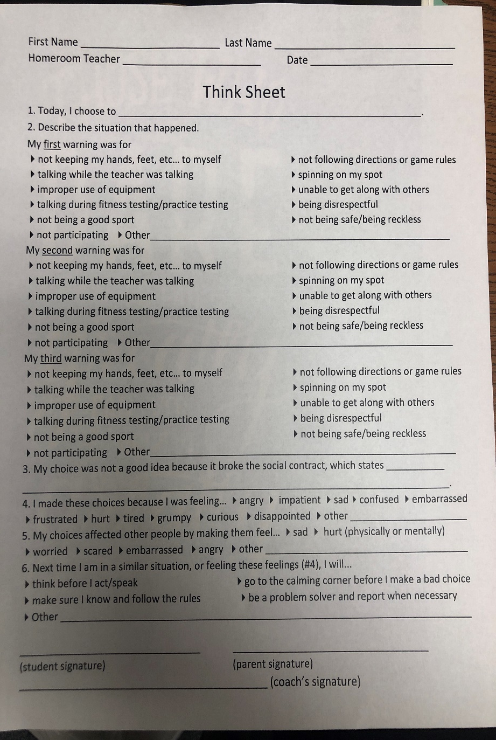
Think Sheet
When do I fill out a think sheet?
When you break the social contract
On your third “strike”
When someone gets hurt (visibly) as a result of my actions.
If I’m making poor choices during a safety drill (fire, lockdown, lockout, etc…)

Slide 11
How to handle disagreements
Talk it out; be a good listener to the other person who you have the disagreement with
Majority rules- if you and another person can’t make a decision, let the majority of kids who agree make the decision
Paper, Rock, Scissors
Always remain RESPECTFUL to each other!

Slide 12
PE Jobs
*Materials/Equipment Managers
Help coaches put out and put up equipment needed for the day
*Champs Champions
Take the Champs buck for the day back to class
Coaches “eyes and ears”→ Tell coaches if you catch someone doing something good
*Door helpers
Close doors at the beginning of class
Open and prop open doors at the end of class before leaving
*Stretch Leaders
Do stretches correctly
Count out loud for each stretch
* Coach Assistant
Help coaches show how to do activities
Help coaches with any errands/things that need to be done
*Ask Me Person
Needs to listen to all directions given that day and understand them
Explains/helps another student in their class if someone didn’t hear directions or didn’t understand the directions
* Reminder Person
Checks the table for an items left on the desk (Rockwall side)
Checks to make sure jackets are taken from the hangers (chin-up bar side)
*Substitute
If someone, with a job is absent, do their job.

Slide 14
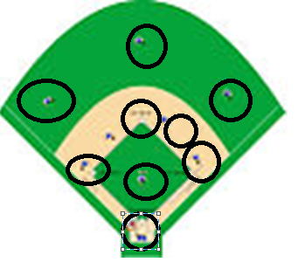
Reward Systems
Individual Rewards= LAMPS Bucks
Tell us when you want to use them; must have bucks with you-can’t go back to your class to get them; YOU are responsible for your own bucks
Treasure box days are: red, orange, yellow days ONLY
Whole Group= Baseball diamond completion
Rewards= board game day, pick the game we play (majority rules), glow in the dark party, other ideas?
CHAMPS Bucks

Slide 15
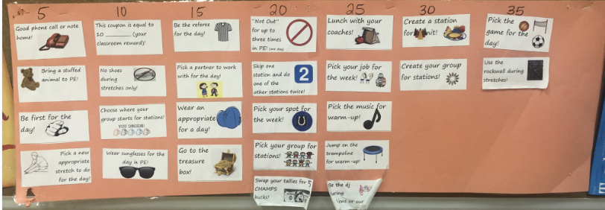
Rewards Continued…
Trade in your LAMPS bucks for coupons
You may combine LAMPS bucks (bucks you have earned in music, STEM, library, and art to buy coupons in PE, BUT ½ or over ½ of your bucks have to be from PE to cash them in in PE

