Slide 1
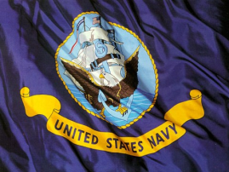
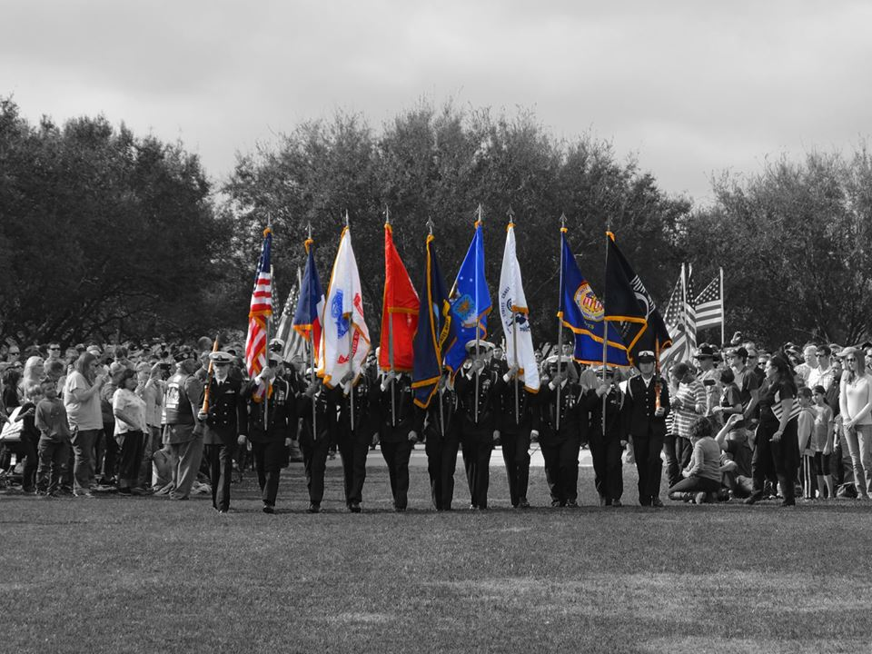
U.S. Navy Grooming Standards Navy JROTC

Slide 2
Female Hair Regulations
Hairstyles must allow for the proper fit of headgear and fit squarely on the head.
In uniform, hair may touch, but not fall below a horizontal line level with the lower edge of the back of the collar.
Layered hairstyles are authorized, provided that the layers present a smooth graduated appearance. No portion of the bulk of the hair (except the bun) as measured from the scalp will exceed 2 inches.

Slide 3
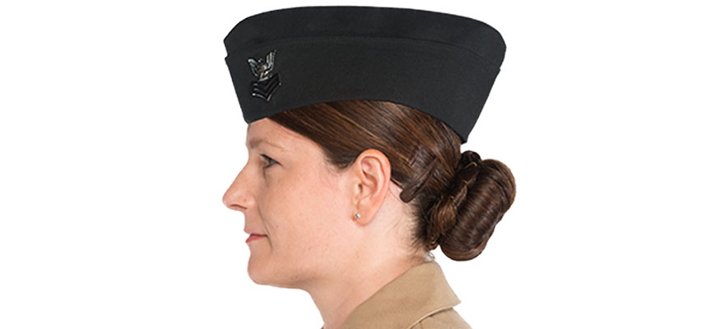
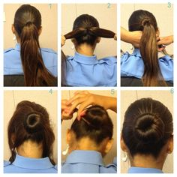
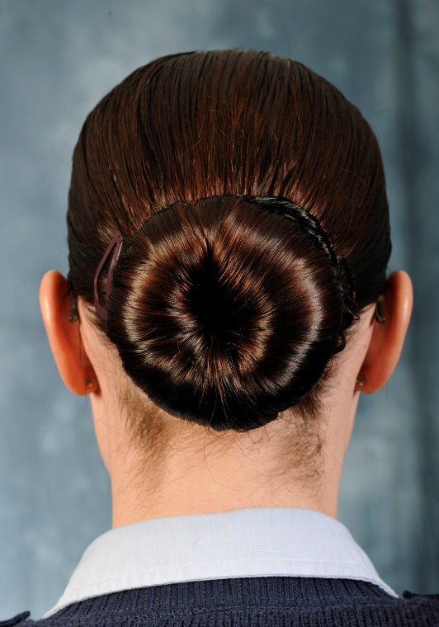
Female Hair Regulations

Slide 4
Female Hair Regulations
Ponytails – A single braid, French braid, or a single ponytail is authorized in Navy Service Uniform.
Hair accessories must not be visible when facing forward.
Hair accessories must be consistent with hair color.
End of ponytail cannot extend lower than 3 inches below the collar of the shirt, jacket, or coat.
Hair buns will not extend more than 3 inches from the scalp.
Hair buns width or diameter will not exceed or extend beyond the width of the back of the head.

Slide 5
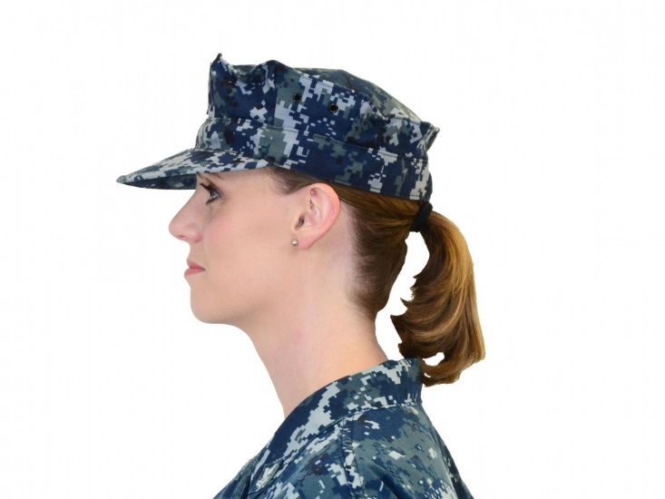
Female Hair Regulations

Slide 6
Female Hair Regulations
Angled hairstyles may not exceed 1 1/2 inches difference in length from front to back.
All hairstyles must minimize scalp exposure.
Two strand braids (a type of twist) are authorized. Braided hairstyles shall be conservative and conform to the grooming standard guidelines.
When hair accessories are worn, they must be consistent with the hair color. A maximum of two small barrettes, similar to hair color, may be used to secure the hair to the head.

Slide 7
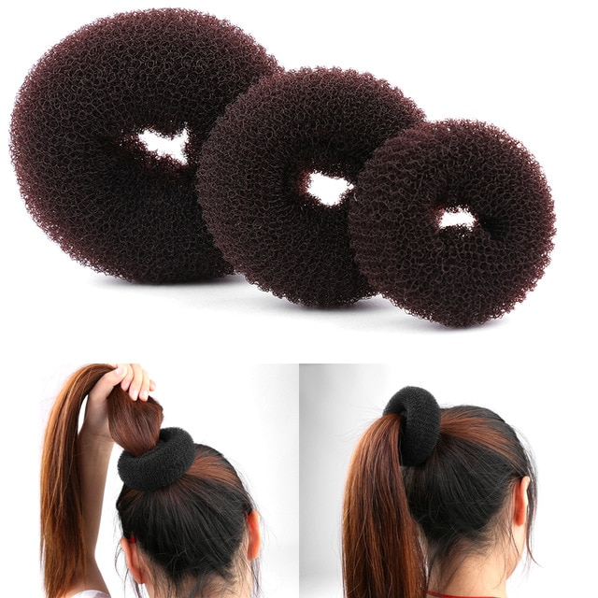
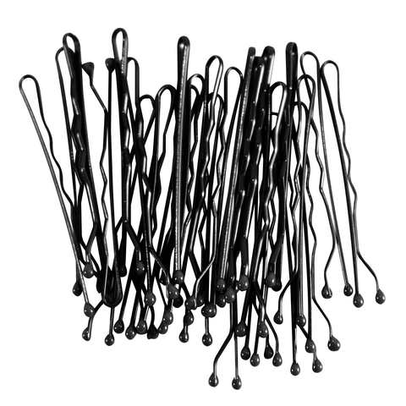
Female Hair Regulations
Bun accessories (used to form the bun), are authorized if completely concealed. Additional hairpins, bobby pins, small rubber bands, or small thin fabric elastic bands may be used to hold hair in place, if necessary.

Slide 8
Female Hair Regulations
Locks must continue from the root to the end of the hair in one direction (no zig-zagging, curving, or ending before the end of the lock to dangle as a wisp or loose hair) and should encompass the whole head. Locks partings must be square or rectangle in shape in order to maintain a neat and professional appearance.
Locks can be loose (free-hanging where no hair is added to the lock once it is started other than hair extensions that are attached at the end of the natural hair). When worn loose, locks will be spaced no more than three-eighths of an inch apart, diameter/width will not exceed three-eighths of an inch, and locks will be tightly interlaced to present a neat and professional military appearance. Locks may also be worn in a bun provided all hair grooming requirements are met. Locks may not be worn in combination with other hair styles (e.g. twists, braids).

Slide 9
Female Hair Regulations
http://www.navy.mil/ah_online/um/femalehair.html

Slide 10
Male Hair Regulations
Because it is impossible to provide examples of every appropriate or unacceptable hairstyle or of “conservative” or “eccentric” grooming and personal appearance, the good judgment of leaders at all levels is key to enforcement of Navy grooming policy. Therefore, hair/grooming/personal appearance while in uniform shall present a neat, professional appearance.

Slide 11
Male Hair Regulations
Hair on the back of the neck must not touch the collar.
Hair shall be no longer than four inches and may not touch the ears, collar, extend below eyebrows when headgear is removed, show under front edge of headgear, or interfere with properly wearing military headgear.
The bulk of the hair shall not exceed approximately two inches. Bulk is defined as the distance that the mass of hair protrudes from the scalp.

Slide 12
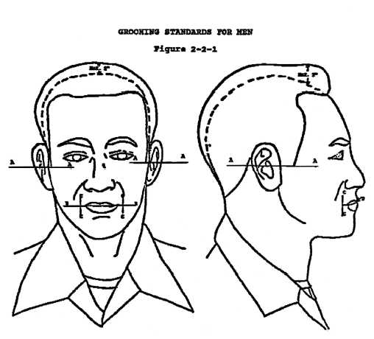
Male Hair Regulations

Slide 13
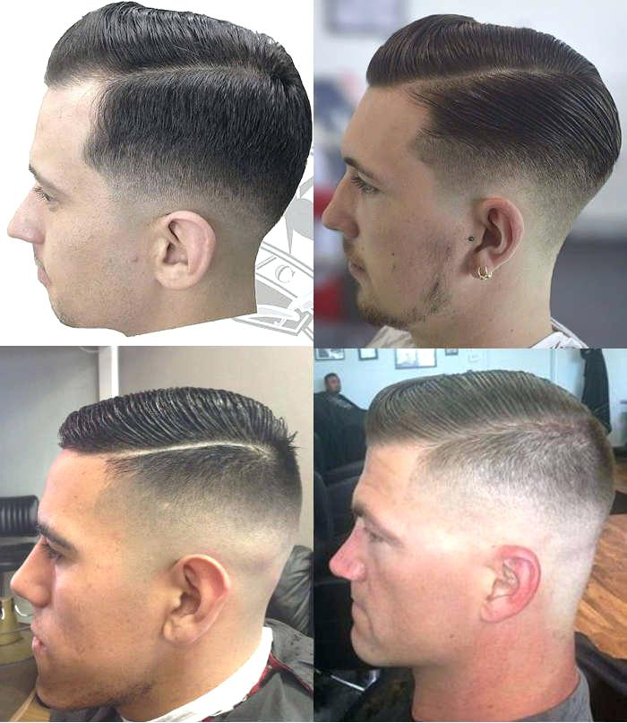
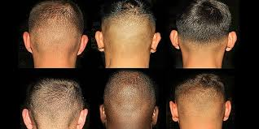
Male Hair Regulations

Slide 14
Male Hair Regulations
Faddish styles and outrageous multicolored hair are not authorized.
Sideburns shall not extend below a point level with the middle of the ear, shall be of even width (not flared) and shall end with a clean shaven horizontal line.
One natural, narrow, fore and aft part is authorized.

Slide 15
Female Cosmetics
Cosmetics may be applied in good taste so that colors blend with natural skin tone and enhance natural features.
Exaggerated or faddish cosmetic styles are not authorized with the uniform and shall not be worn.
Lipstick colors shall be conservative and complement the individual. Long false eyelashes shall not be worn when in uniform.

Slide 16
Fingernail Regulations
Men: Fingernails shall not extend past fingertips. They shall be kept clean.
Women: Fingernails shall not exceed 1/4 inch measured from the fingertip. They shall be kept clean. Nail polish may be worn, but colors shall be conservative and complement the skin tone.

Slide 17
Jewelry
Conservative jewelry is authorized for all personnel and shall be in good taste while in uniform. Eccentricities or faddishness are not permitted.
While in uniform, only one ring per hand is authorized, plus a wedding/engagement ring set. Rings are not authorized for wear on thumbs.

Slide 18
Earrings
Men: Not authorized while in uniform.
Women: One earring per ear (centered on earlobe) may be worn while in uniform.
Earrings shall be 4mm - 6mm ball (approximately 1/8 - 1/4 inch), plain with shiny or brushed matte finish, screw on or with posts.
Gold for officers/CPOs, and silver for enlisted personnel.

Slide 19
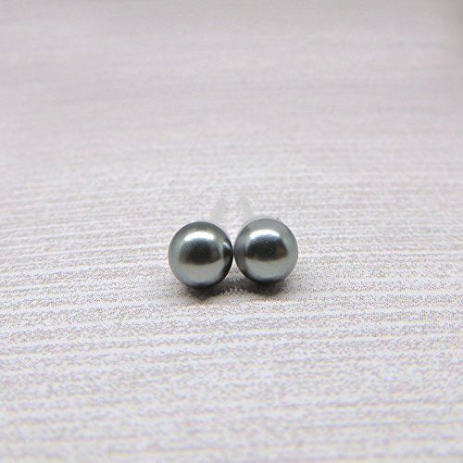
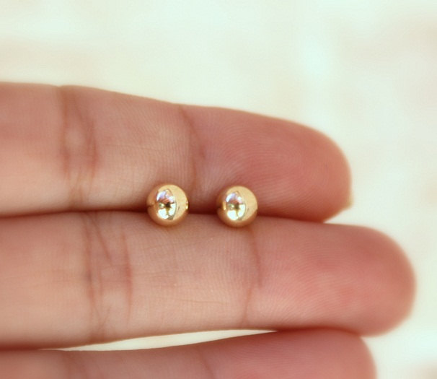
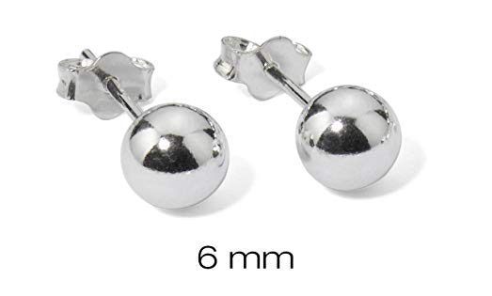
Earrings (cont)

Slide 20
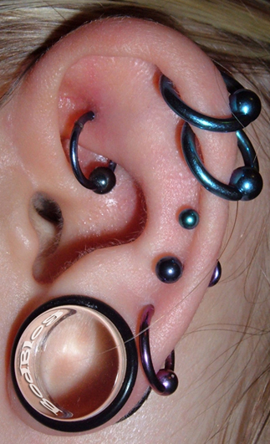
Body Piercing
Not authorized while in
uniform. No articles, other
than earrings for women
specified above, shall be
attached to or through the ear,
nose, or any other body part.

Slide 21
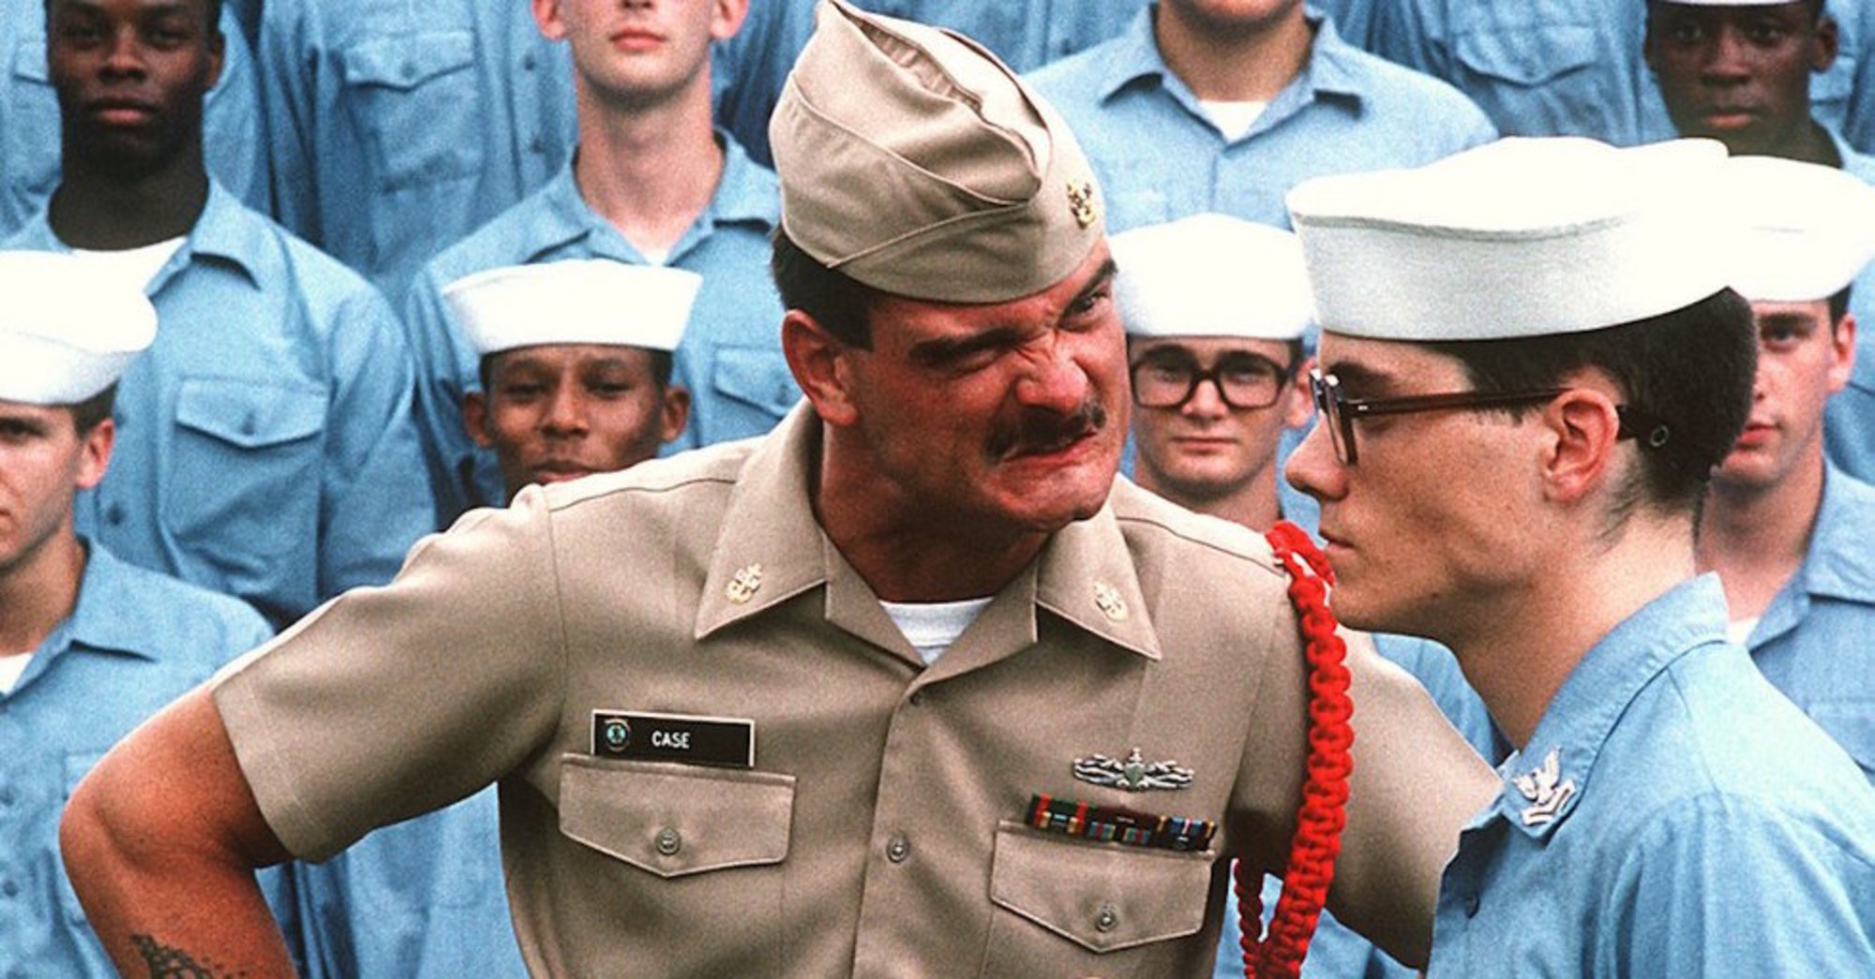
QUESTIONS?

