Slide 1
Schoology for Parents (Basic)
Notes:
Thank you for joining use for the Schoology course for Parents. This training will focus on the basic features of Schoology. We are also offering an advanced Schoology course. This course is designed to walk parents through the process of how to login to Schoology and a basic tour of the platform.

Slide 2
Colony Bend Support Contacts
Shweta Khade
Phone # 281-634-4082
Email: Shweta.Khade@fortbendisd.com
Karol Hartman
Phone # 281-634-4085
Email: Karol.Hartman@fortbendisd.com
Anagha Machado
Phone # 281-634-7394
Email: Anagha.Machado@fortbendisd.com
Angela Moten
Phone # 281-634-4087
Email: Angela.Moten@fortbendisd.com
Notes:
Time: 2 min
Presenter:
Please customize this slide, feel free to add more contact person or minimize contact person if there will only be one contact on your campus.
Introduce yourself, the campus name and contacts for parents to call in case of questions.

Slide 3
How are you feeling about using Schoology?
Excited
Unsure
concerned
1
2
3
Notes:
Time: 3 min​
Materials:​
Strategy:​
Presenter:
Say: Before we jump into all the learning for today, I’d like to take a quick poll and just get a temperature check on how everyone is feeling about using Schoology. Please take a moment to look at these emoji's, which one represents you the most. Just simply type in the number in the chat box.
Do: Presenter is to monitor the chat to get a sense of how parents are feeling
Say: (Make a comment about what the majority of parents are feeling and validate their emotions especially if they are feeling concerned) We are hoping that by end of this session and any other parent session you participate in that we start to shift your mind to the excited Emoji. We know change is hard but rest assured FBISD is going above and beyond to ensure student received quality instruction. And with that lets, look at our session goals.

Slide 4
Instructional Tools
Notes:
1 minute
Say: As we start the 2020-21 school year, we are working to standardized the major instructional tools we use, so parents and students will know what tools to utilize and we can ensure consistency and quality across all courses.
We will briefly introduce the purpose of teach of the tools and then go more in depth with Schoology.

Slide 5
Instructional Tools
Notes:
2 min.
Say: Skyward is our student information system and includes schedules, the gradebook, the attendance record, discipline, etc.
Through Skyward, we are able to monitor progress as of official progress and grade reporting periods.
It houses the official gradebook, attendance and disciplinary records for students.

Slide 6
Instructional Tools
Notes:
2 min
Say: Microsoft Teams will be used for live, real time, synchronous instruction via videoconference with teachers and students. And it will be utilized with small group instruction.
In Teams, the teacher and students can share documents, files and links to assist students with collaboration. It is a more secure environment for collaboration and engagement that integrates with Microsoft Office 365.

Slide 7
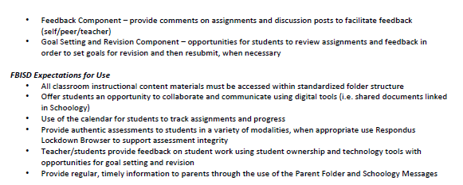
Instructional Tools
Featured Today!
Notes:
2 min
Say: Schoology is our Learning Management System and is where teachers post lessons and assignments for students and give feedback. It is where students will engage with each other through collaboration tools and where students will submit their assignments.
-In an effort to improve the instructional experience for students, there are standardized folder structures and frameworks within Schoology this year.
-Additionally, students will see the Respondus LockDown Browser when they are required to take secure assessments inside Schoology. This is a new tool to secure online tests. Students will be locked out of visiting other programs or sites on their computer while taking an assessment.
-FBISD now has FBISD 1Link which will support improved access through a single sign-on and can provide data analytics to teachers on student engagement with the learning.

Slide 8
Learning Goals
By the end of this session, you will be able to:
Access Schoology as a parent and notice the difference between student and parent access
Understand the components of a FBISD Schoology dashboard
Customize settings and notifications
Use the web or mobile app to navigate within the Schoology platform as a parent
Notes:
Time: 2 minutes
Materials:
Strategy:
Presenter Notes:
These Learning Intentions outline what you will learn through this webinar.
Allow participants a minute to read the learning intentions.
As note, there are features your child will have that is unavailable to you, as a parent. It is also important to remember. For confidentiality reasons, you should not log into Schoology using your child’s login.

Slide 9
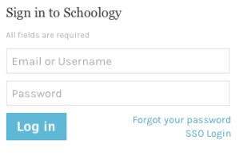
Current Way to Login
Use the email address you use to access Skyward
Navigate to www.fortbendisd.com.​​
Click on the Parents and Students tab.​​
Click on Schoology-Parent Login.​​
Click on Login to Parent Schoology.​​
Click on the Forgot Your Password link.​​
Type in the email that was used to register for Skyward Family Access.​
Notes:
Time: 2 minutes
Materials: Schoology-Parent How To Change Password Job Aid
Presenter Notes: If the presenter is not a parent in the district, he/she need access to a parent account to model the steps below. Model the steps on your presentation screen for all participants.
Say: The current procedure for initially setting up your Schoology account causes you to navigate through the "forgot password" process. Since the account is drawn from your Skyward Family Access information, using the "forgot password" option is the quickest and most efficient means for parents to access their username, password and account. In addition, if you have students at multiple schools within Fort Bend ISD you will see each child within your Schoology account.
(Demonstrate as you go through each step)
1: Navigate to www.fortbendisd.com.
2. Click on Parents and Students.
3. Click on Schoology-Parent Login.
4. Click on Login to Parent Schoology.
5: Click on the Forgot Your Password link.
6: Type in the email that was used to register for Skyward Family Access.
Job Aid: https://www.fortbendisd.com/cms/lib/TX01917858/Centricity/domain/74/1.%20teaching%20and%20learning/schoology%20webpage/Schoology%20-%20Parent%20How%20to%20Change%20Password.pdf

Slide 10
Setting Up Your Account
Let's Walk Through the Steps Together:
Click on Send My Login Info.
When you use the correct email address (same as Skyward), you’ll receive a message that states: 'Further instructions have been sent to your email address'. If you used an incorrect email address, you’ll receive a message that states: 'The email address you entered does not belong to any account'.
When you enter the correct email address, you will receive 2 emails: 1 from notifications@schoology.com and 1 from no-reply@schoology.com.
Go ahead and check your email at this time. You will want to check your spam folder in case the emails were sent there.
Click on the Log In link in the email you received. This will allow you to reset your password and receive your username.
The password reset screen will show your username that can also be used to sign into Schoology. We recommend using the email address you previously used. Type in your new password and click Submit. You should receive confirmation at the top of the page that your password has been changed.
Click the dropdown by your name to see your linked children.
You can also download the Schoology app from the Apple and Android store but you must first set up your account through the browser before using the Schoology app.
Notes:
Talk through the steps to access Schoology. Watch the chat for any questions and respond.
(Demonstrate as you go through each step)
7: Click on Send My Login Info.
8: If you used the correct email address, you’ll receive a message that states: 'Further instructions have been sent to your email address'. If you used an incorrect email address, you’ll receive a message that states: 'The email address you entered does not belong to any account'.
9: If you entered the correct email address, you will receive 2 emails: 1 from notifications@schoology.com and 1 from no-reply@schoology.com. Go ahead and check your email at this time. You will want to check your spam folder in case the emails were sent there. (Give them a moment to check email AND WALK AROUND TO PROVIDE ASSISTANCE)
10: Click on the Log In link in the email you received. This will allow you to reset your password and receive your username.
11: The password reset screen will show your username that can also be used to sign into Schoology. We recommend using the email address you previously used. Type in your new password and click Submit. You should receive confirmation at the top of the page that your password has been changed.
12: Click the dropdown by your name to see your linked children.
10: You can also download the Schoology app from the Apple and Android store but you must first set up your account through the browser before using the Schoology app.
Job Aid: https://www.fortbendisd.com/cms/lib/TX01917858/Centricity/domain/74/1.%20teaching%20and%20learning/schoology%20webpage/Schoology%20-%20Parent%20How%20to%20Change%20Password.pdf

Slide 11
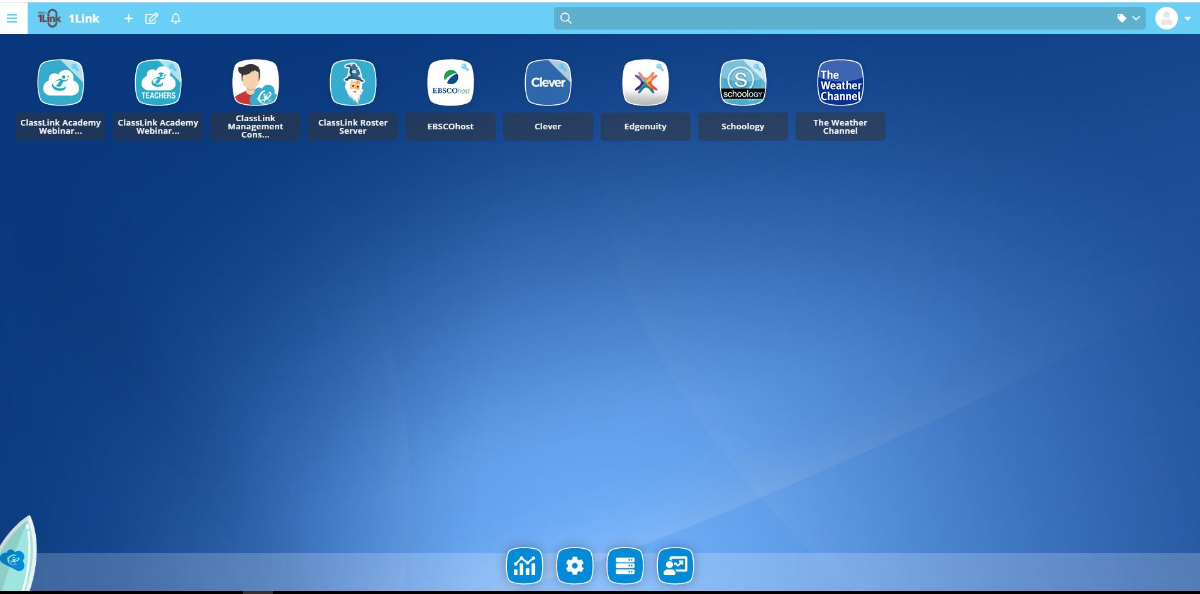
Coming Soon!
One Unified Login
Notes:
1 min
Say: Soon you will receive communications about a new unified login through 1Link. 1Link will allow students to access all of their resources through one login. The top picture is the page where the student will login and the bottom picture represents what the screen will look like once they login.
Parents, you will receive communications soon regarding 1Link and how students should initiate their access.

Slide 12
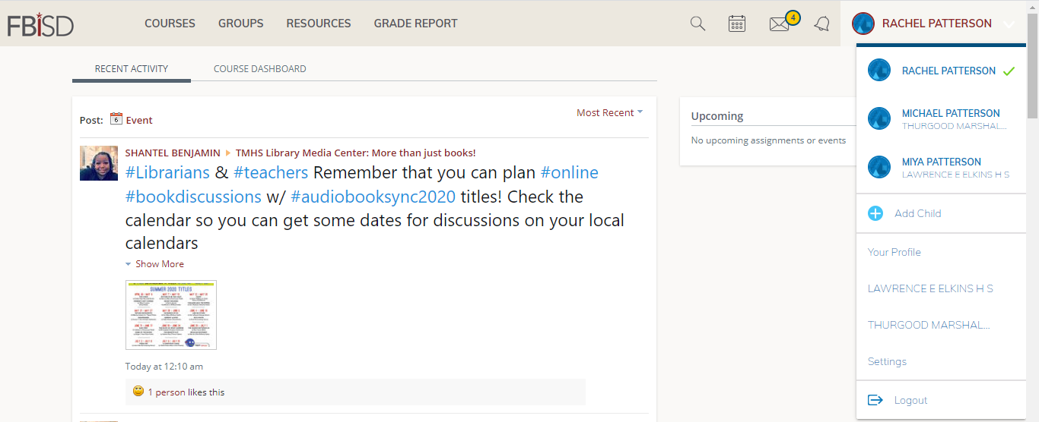
Customizing Your Account
Drop Down Menu
Parent
General Announcements
Student 1
Student 2
Notes:
Say: Let’s Talk about Customizing Your Account in Schoology.
Time: 5 minutes
Say and Demonstrate: Once you have logged in to the platform, you will see a similar landing page for your child’s Schoology account. On this page, you can view general announcements from your child’s school, important dates on the calendar, and see the icon for messages sent and received by a teacher. Across the top are Home, Courses, and Groups. These tabs stay on every page in Schoology. To the right is your name and a drop down for setting up notifications and also for switching between children if you have more than one child within the district. To view another child's account, simply click on the arrow next to your name in the upper-right corner and choose the child you'd like to view.
Say and Demonstrate: You also have the ability to set up notifications. To set up notifications, you will go to the dropdown in the top right corner and select Settings. Then select the “Notifications” tab within the settings area. There are 2 types of notifications you may choose to have. The 1st is an email digest of your child’s activity within Schoology. Select 'On', select if you want it daily or weekly', select the 'time' you’d like to receive the email, and if you selected weekly, select the 'day' you’d like to receive the report. If you choose daily, you will select the time. You may also set up to receive overdue submission emails. This will send an email if an assignment was given and it was not turned in on time or is late. After making your selections, click Save Changes.
You may also notice an envelope icon with a circled, highlighted number. This indicates a message from the teacher. (Click to next slide.)

Slide 13
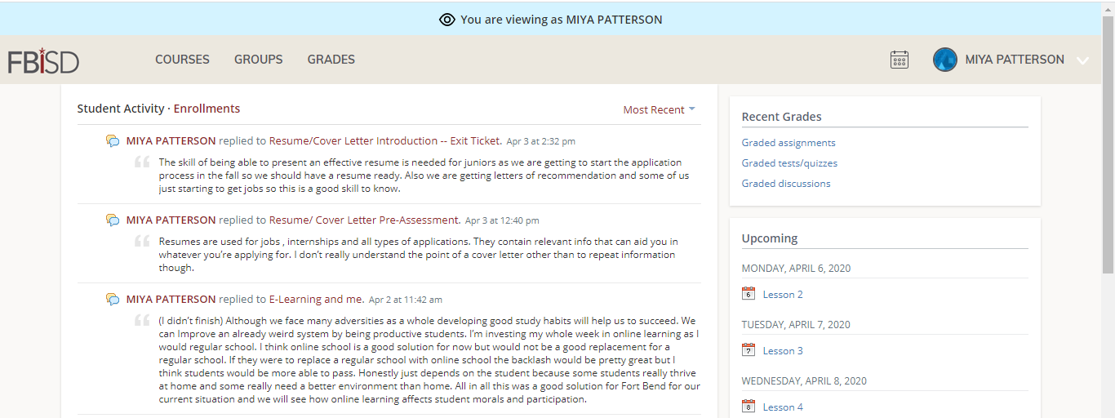
Navigating Schoology
Select student’s profile
Click to see
Schoology grades
Calendar events entered by the teacher
Activities your student has engaged in within their courses
Notes:
Time: 10 minutes
Materials: Navigating Within Schoology PDF
Strategy:
Presenter Notes: see the courses and groups your child is a part of and click on Student Activity to see your children’s activity
Say: Here we will walk through the different views and information you can see from within your child’s Schoology account. Be aware that parent access and student access to information within Schoology is not the same. Parent access is designed to help the adult monitor and support the student’s participation in online learning. To maintain others’ privacy, parents are not able to see submissions of other students and engage in some features of the platform.
Say and Demonstrate: To the right, you will see recent grades, any overdue assignments, and upcoming assignments that have been entered by the teacher. Keep in mind, the grades in Schoology only represent assignments done in this platform. Official grades of record are posted in Skyward.
Say and Demonstrate: Let’s talk about the main homepage. It is divided into 2 sections. On the top is the quick menu bar. Here you will have buttons to access your child’s classes and any groups they are a part of. The courses tab lists all the courses that your child is currently taking. You may also see any groups that they are a part of. This could be for a sport or club they have joined. There is a tab for grades and attendance, but remember, Skyward is the official record for all grades and attendance so the only data you would see here are assignments done within Schoology. In the middle, there is a running list of the activities and assignments that your student has engaged in throughout all courses in which they are currently enrolled.
On the right, there is also a calendar, which lets you see assignments and due dates that are posted for your child for Schoology related assignments. On the far right is a section for recent grades. Again, Skyward is the official record of all grades but anything done within Schoology such as an assignment, a test or quiz, or a discussion that might have been graded will be here. Beneath it is upcoming. This will show upcoming assignment or events that the teacher may have assigned.
Let’s click on a course. (Advance to the next slide.)

Slide 14
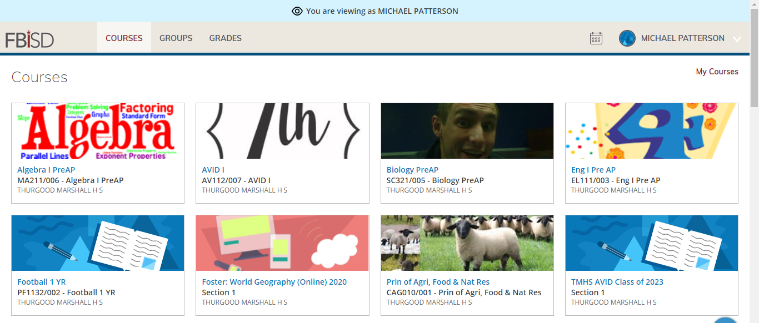
Notes:
Time: 10 minutes
Materials: Navigating Within Schoology PDF
Strategy:
Presenter Notes: see the courses and groups your child is a part of and click on Student Activity to see your children’s activity
Say: When you click courses, it will take you to a group of icons that represent each course for the child who is currently selected. Once you select a course (Click on a course), you will see very similar information on the left: materials, updates, grades, and members, but you only get access to your child’s work. Materials that might be posted such as discussions, you’ll see your child’s discussion and his/her participation in that discussion only. For an assignment, you’ll be able to see what they posted. If you would like to go back to the home page, click on the FBISD logo in the top left corner, or if you want to navigate to another course, click on Courses and select a new course you’d like to view.

Slide 15
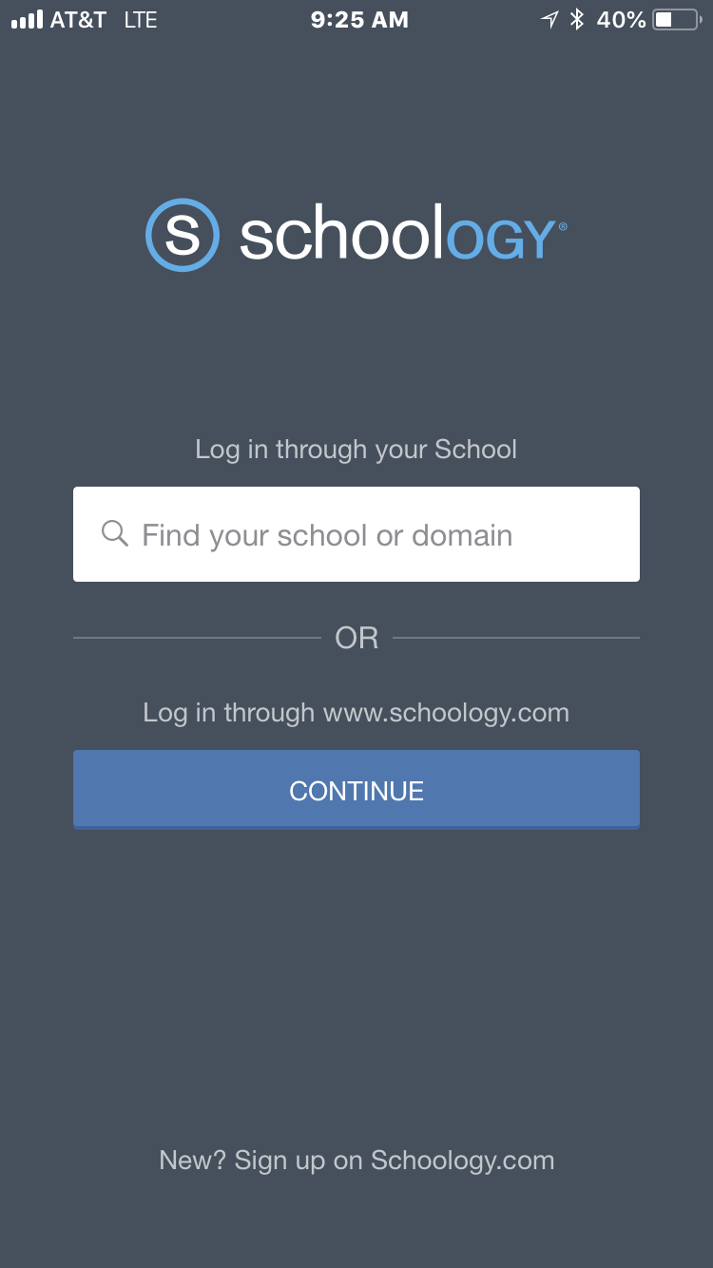
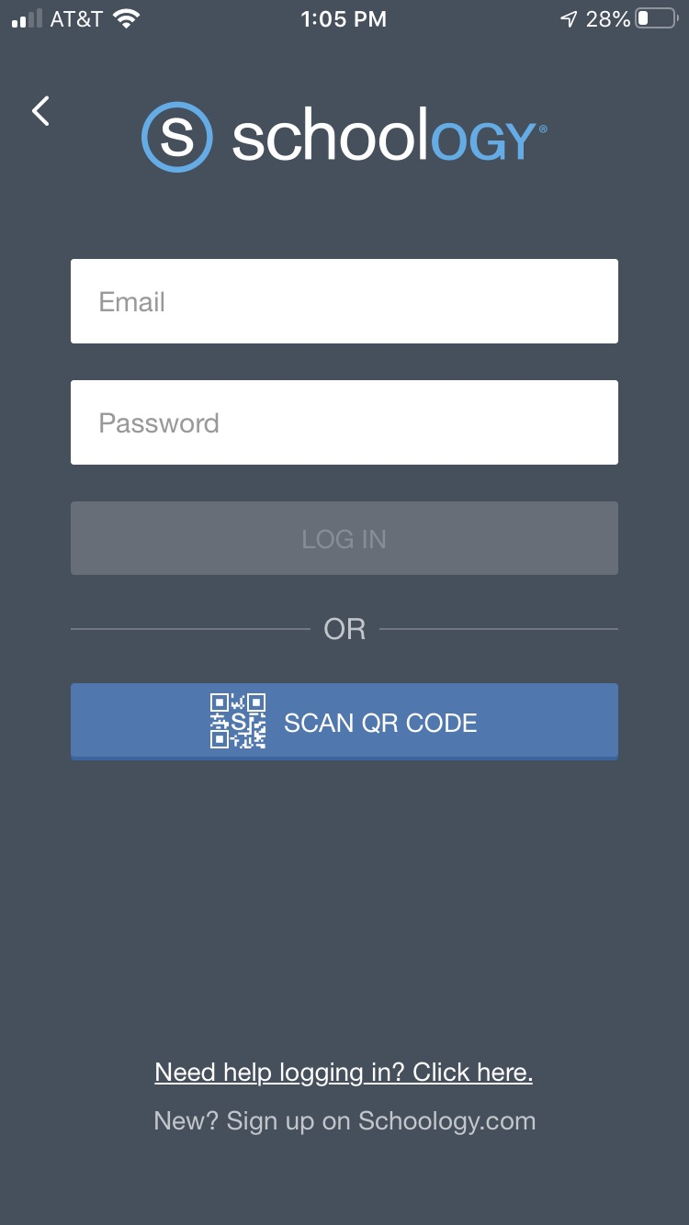
Schoology Mobile App
Notes:
Time: 4 minutes
Materials:
Strategy:
Presenter Notes:
Say: Schoology can also be accessed through the mobile app. It only takes a few minutes to download the app and set up our account. However, you must have already set up your Schoology account using a web browser in order for the app to login to your existing account.
First, go to the App store or Google Play on your mobile device and search Schoology. Then download the app.
Launch the app and you will see a screen asking you to select a school or district.
Click on the Blue continue button.
Input the email address you currently use to log in to Skyward as well as the password and then click “Log In”.
You may share this brief video created by an FBISD teacher demonstrating how to download the app using an Android phone:
https://youtu.be/jiH-CVIz4WA
(English)
https://youtu.be/DfcufPVXziw (Spanish)

Slide 16
Parent Support
FBISD Schoology Job Aides and Tools may be located at:
https://www.fortbendisd.com/Page/124794
Schoology’s Help Center: https://support.schoology.com/hc/en-us
Notes:
Time: 1 minute
Materials:
Strategy:
Presenter Notes:
Share information on slide and explain they can visit the website for support options for Schoology and other online learning platforms being used by FBISD teachers.

Slide 17
How are you feeling about the 2020-2021 launch of school?
Excited
Unsure
concerned
1
2
3
Notes:
Time: 2 min​
Materials:​
Say: Now that we’ve concluded the session, I’d like to revisit our emoji’s from the beginning, I’d like to see if any your minds have shifted yet after hearing today’s presentation. Do you feel more comfortable and excited about the launch of the school year, are use still unsure or are you concerned. Please take a moment to indicate which one represents you the most now. Just simply type in the number in the chat box.
Do: Presenter is to monitor the chat to get a sense of how parents are feeling, if there is a change from the second slide mention it.

Slide 18
Questions
Notes:
Say: This brings us to the end of the training. I hope you have a better understanding of how to use Skyward’s Family Access as a communication tool. If there are any questions, please unmute to ask now or you may type the question in the chat now.
When done, thank everyone for coming.

