Slide 1
Structuring for Success for Parents
Notes:
Time: 2 min
Introduction of Presenter(s):
Say: Welcome to the Structuring for Success webinar! My name is ______________ and I am here with ______________ from ______________ (name of school).
-We are excited to have you all here today as we share information to about FBISD expectations.
-Before we begin our session we’d like to go through some house keeping items.
-We ask that you please mute your mics as we go through our presentations today, just to avoid any feedback. To mute your mics, simply , locate the tool bar at the bottom of your screen and click on the icon that looks like a microphone, you will see a line go through the mic, this indicates it is muted.
-Please feel free to leave your cameras on or off, whatever you are more comfortable with. To turn your camera off or on, you will click on the camera located at the bottom of the screen.
-And finally, if at anytime you have a questions please put them in the chat box and the facilitator or myself will answer your questions the best that we can, we will also have time for Q&A at the end of our session so feel free to hold your questions to the end if you'd like. To type in the chat, located the tool bar at the bottom of your screen and click on the bubble that looks like it has text. Just to make sure everyone can use this feature, I’d like for you to please type a quick hello in the chat to ensure you are able to use this feature.
-Welcome again. Let's get started.

Slide 2
Colony Bend Support Contacts
Shweta Khade
Phone # 281-634-4082
Email: Shweta.Khade@fortbendisd.com
Karol Hartman
Phone # 281-634-4085
Email: Karol.Hartman@fortbendisd.com
Anagha Machado
Phone # 281-634-7394
Email: Anagha.Machado@fortbendisd.com
Angela Moten
Phone # 281-634-4087
Email: Angela.Moten@fortbendisd.com
Notes:
Time: 2 min
Please customize this slide, feel free to add more contact person or minimize contact person if there will only be one contact on your campus.
Introduce yourself, the campus name and contacts for parents to call in case of questions.

Slide 3
How prepared do you feel for the start of online instruction at the start of school, August 17?
Excited
Unsure
Concerned
1
2
3
Notes:
Time: 2 min​
Say: Before we jump into all the learning for today, I’d like to take a quick poll and just get a temperature check on how everyone is feeling about your readiness for the launch of the 2020-2021 school year online. Please take a moment to look at these emoji's, which one represents you the most. Just simply type in the number in the chat box.
Do: Presenter is to monitor the chat to get a sense of how parents are feeling
Say: (Make a comment about what the majority of parents are feeling and validate their emotions especially if they are feeling concerned) We are hoping that by end of this session and any other parent session you participate in that we start to shift your mind to the excited Emoji. We know change is hard but rest assured FBISD is going above and beyond to ensure student received quality instruction. And with that lets, look at our session goals.

Slide 4
By the end of this session, you will be able to:
Session Goals
Understand District expectations for elementary, middle, and high school online learning schedules
Recognize scheduled times for synchronous and asynchronous learning
Employ appropriate space applications to maximize student learning from home
Utilize District support resources to assist at-home/online learning
Know of technology services and supports rendered by the District.
Notes:
Time: 2 min​​
​
Say: Read the session goals to the parents ​

Slide 5
Our Mindsets
Positive talk
Plan
Encourage
Communication
Notes:
2 min​​
Say: As we enter into the new school year, let's keep these key elements in mind to set the tone for a successful school year.
Engage in positive talk and have a positive mindset. Research demonstrates that strong relationships between schools, families, and community members can positively affect student achievement and outcomes. Remember, your child is watching and learning from your every move and action, encourage a positive talk as much as possible.
Planning helps identify and ultimately achieve goals. When a team (like the parent and child) work together to set goals, it allows everyone to be on the same page, working toward a common, shared purpose.
Encouragement and support sets the tone when learning new skills and concepts. It is important to acknowledge when your child is excelling and to positively reinforce their behavior while doing so. Remember, there are steps to the learning process, be sure to celebrate their success along the way.
Communication is a key element with parent involvement. Be sure to contact your child's teacher and utilize all available resources from your child's campus and the District. We are here to support you!
As we proceed with the webinar, we want to assure you that, even though the school year will look very different than any year we have lived to date, we are here and ready to support you to ensure your child has an outstanding year.

Slide 6
Session Topics
Schedules
Technology
Student Work Space
Support Resources
Notes:
Time: 2 min​​
​
Say: Let's briefly view the topics for our session.
Today we will discuss:
Daily Schedules. This 2020-21 schedule will appear completely different from the schedule used in the Spring. The schedules are more structured and will permit time for synchronous and asynchronous instruction. Daily, synchronous learning will be the foundation of our instructional program. Teachers and students will have a full daily schedule of teaching and learning.
Student Work Space. The right workspace makes a huge difference in students’ mindset and ability to focus. When participating in e-learning, students have the ability to complete their work where they want, so it’s important to put thought into what kind of environment is truly most effective for them and make sure that they have a designated space at home.
Technology. Students and families will experience an improved online experience as we begin the new year with improvements with the learning experience delivery, the use of Schoology, and consistent progress monitoring and feedback. Additionally, we will review the Technology distribution plan for families in need of a device.
Support Resources. We will review the At-Home Learning resources available from the District website.
Let's begin!

Slide 7
Schedules
Notes:
Say: Now we will transition to student schedules

Slide 8
Daily Attendance
Students will be marked present daily in grades 3-12, when they are engaged in the synchronous/live online instruction at the designated daily time.
Students in grades PK-2nd will be marked present when they are engaged in asynchronous instruction, which means daily progress monitoring in our Learning Management System, Schoology, and daily progress via teacher-student interactions, including synchronous time on the daily schedule.
All students will have attendance taken daily by class period to count toward course credit.
All students are expected to demonstrate daily progress in asynchronous learning through Schoology:
Daily engagement such as completion of assignments,
Demonstration of academic progress, and
Communication to and from the teacher related to the coursework.
Notes:
2 min
Say: Attendance in the online environment will look differently than it did last spring. Teachers are required to record attendance daily.
-For students in grades 3-12, attendance is based on being engaged in the synchronous/live lessons daily at the designated time.
-For grades PK-2nd grade, students are marked present through asynchronous engagement daily.
-All students must make daily progress in their courses through synchronous and asynchronous learning and attendance will be taken daily in all courses to count toward course credit.
-FBISD utilizes Blackboard Connect to notify parents when students are marked absent.
-The Blackboard Connect system sends weekday daily attendance messages to parents for students who are marked absent.

Slide 9
Planning Your Child’s Daily Schedule
Step 1
Review communications about your child’s grade level expectations for each subject.
Step 2
Consider the children in your household, their grade level expectations, devices available in the household, and parental support needed.
Step 3
Step 4
Plan a schedule with daily content time for each child in your home, considering the communicated expectations. Consider the best space for your child to do their work.
Consider other supports your child needs, such as exercise, mental breaks, meals, etc.
Notes:
Time: 2 min​​
​
Say: When planning your child's daily schedule, follow this 4 step process:
Step 1: Review communications about your child’s grade level expectations for each subject.
Step 2: Consider the children in your household, their grade level expectations, devices available in the household, and parental support needed.
Step 3: Plan a schedule with daily content time for each child in your home, considering the communicated expectations. Consider the best space for your child to do their work.
Step 4: Consider other supports your child needs, such as exercise, mental breaks, meals, etc.

Slide 10
Master Schedule – Online Learning ​
Prekindergarten – 1st Grade
A student’s daily schedule may look like the example provided below.
Time | Synchronous Learning Experience
8:50 – 9:05 | Synchronous Outclass
9:10 – 9:40 | Synchronous Reading w/Small Group
9:40 – 9:55 | Synchronous Writing
9:55 – 10:25 | Synchronous-Science (MWF), Social Studies (T/TH)
11:30 – 12:30 | Lunch/Recess
12:30 – 1:00 | Synchronous Math w/Small Group
1:00 – 1:45 | Synchronous Small Group Intervention/Enrichment
Planned asynchronous learning experiences will be provided to students, but students and their family have the flexibility of when to engage in those asynchronous learning experiences throughout the day.
Notes:
Time: 2 min​​
Presenter:​ ***********Hide this slide if you are a secondary campus************
Say: Now we will take a look at the schedule for PreKindergarten to 1st grade elementary students. The first scheduled time of 8:50-9:05 is dedicated to synchronous outclass. The content "Outclass" refers to the enrichment classes such as Art, Music, STEM and P.E. And for 15 minutes students will participate in Outclass synchronous instruction; that means teachers and students will engage in learning at the same time. The next time on the schedule is 9:10 to 9:40, this time is identified as synchronous Reading with small group. Again, synchronous instruction is learning that happens "at the same time", exactly what you are doing here today with me. Through the online remote format, teachers will be able to engage with students in real time. This schedule highlights synchronous learning opportunities which include various instructional content areas, small group interventions and enrichment with varied times.
The 11:30-12:30 time slot is an opportunity for students to have a break, eat lunch and engage in an outdoor activity.
Say: Planned asynchronous learning experiences will be provided to students, but students and their family have the flexibility of when to engage in those asynchronous learning experiences throughout the day.

Slide 11
Master Schedule – Online Learning ​
2nd – 5th Grade
A student’s daily schedule may look like the example provided below.
Time | Synchronous Learning Experience
8:35 – 9:00 | Synchronous Reading w/Small Group
9:00 – 9:15 | Synchronous Writing
10:05 – 10:35 | Synchronous Outclass
10:45 – 11:30 | Synchronous Small Group Intervention/Enrichment
11:30 – 12:30 | Lunch/Recess
12:30 – 1:15 | Synchronous Math w/Small Group
1:15 – 2:00 | Synchronous-Science (MWF), Social Studies (T/TH)
Planned asynchronous learning experiences will be provided to students, but students and their family have the flexibility of when to engage in those asynchronous learning experiences throughout the day.
Notes:
Time: 2 min​​
Presenter:​ ***********Hide this slide if you are a secondary campus************
​Say: Now we will take a look at another Elementary student schedule. This is an example of a 2nd – 5th grade schedule. Students will also have asynchronous and synchronous learning opportunities with varied times. Like the kindergarten schedule, they will engage in content area, outclass, enrichment, intervention and small group learning opportunities. The 11:30-12:30 time slot is an opportunity for students to have a break, lunch and engage in an outdoor activity.
Say: Planned asynchronous learning experiences will be provided to students, but students and their family have the flexibility of when to engage in those asynchronous learning experiences throughout the day.

Slide 12
Master Schedule – Online Learning ​
A secondary student’s daily schedule may look like the example provided below.
Time | Monday | Tuesday | Wednesday | Thursday | Friday
9:00 – 10:00 | Synchronous Period 1 | Synchronous Period 5 | 9:00 – 9:35 Synchronous Period 1 | Synchronous Period 1 | Synchronous Period 5
 |  |  | 9:45 – 10:20 Synchronous Period 2
10:15 – 11:15 | Synchronous Period 2 | Synchronous Period 6 | 10:30 – 11:05 Synchronous Period 3 | Synchronous Period 2 | Synchronous Period 6
 |  |  | 11:15 – 11:50 Synchronous Period 4
11:30 – 12:30 | Synchronous Period 3 | Synchronous Period 7 | 12:00 – 12:35 Synchronous Period 5 | Synchronous Period 3 | Synchronous Period 7
12:30 – 1:00 | Lunch |  | 12:35 – 1:05 Lunch | Lunch
1:30 – 2:30 | Synchronous Period 4 | Synchronous Social-Emotional Learning, Intervention, Enrichment | 1:30 – 2:05 Synchronous Period 6 | Synchronous Period 4 | Synchronous Social-Emotional Learning, Intervention, Enrichment
 |  |  | 2:15 – 2:50 Synchronous Period 7
Planned asynchronous learning experiences will be provided to students, but students and their family have the flexibility of when to engage in those asynchronous learning experiences throughout the day.
Notes:
Time: 2 min​​
​Presenter: ************Hide this slide if you are an elementary campus************
Say: Let’s take a look at the Secondary student schedule. This is an example of a Middle and High School online learning schedule. Like the Elementary schedule, students will be provided with asynchronous and synchronous learning opportunities with varied times. However, middle and high school students will have more synchronous learning opportunities with 30 minutes of asynchronous learning opportunities per week. The 12:30-1:30 time slot is an opportunity for students to have a break, lunch and engage in an outdoor activity.
Say: Planned asynchronous learning experiences will be provided to students, but students and their family have the flexibility of when to engage in those asynchronous learning experiences throughout the day.

Slide 13
Typical School Week
Notes:
Time: 2 min​​
​
Say: Now that we have looked at some sample schedules for elementary and secondary students, let's take a look at what a typical school week looks like. For Pre-K, Kindergarten and 1st grade students there are a total of 1800 instructional minutes per week. 825 of those minutes is dedicated to synchronous instruction and 975 minutes are dedicated to asynchronous instruction. For 2nd – 5th grade there are a total of 1845 instructional minutes per week. 1025 of those minutes are dedicated to synchronous instruction and 820 minutes are dedicated to asynchronous instruction. Lastly, Secondary students have a total of 1805 instructional minutes. 1205 minutes of synchronous instruction, 280 minutes of asynchronous instruction and 320 minutes dedicated to mental health breaks and transitions.

Slide 14
Student Workspace
Notes:
Say: Now we will transition to student workspace.

Slide 15
Creating a Space for Online Learning
Is there an area designated at home for online instructional activities?
i.e.: child’s room, kitchen table, small area off of the main living areas, a nook that can be personalized, etc.
Is the area optimal for internet connectivity?
Is there a bulletin board or empty wall space to post schedules, calendars, and completed work?
Are there bookshelves, baskets or bins to help keep supplies organized?
Questions to Consider:
Notes:
Time: 2 min​​
​Say: Let's now take a look at the student workspace and considerations for creating a space for online learning at home. Here are some questions for you to consider:
Is there an area designated at home for online instructional activities? i.e.: child’s room, kitchen table, small area off of the main living areas, a nook that can be personalized, etc.
Is the area optimal for internet connectivity?
Is there a bulletin board or empty wall space to post schedules, calendars, and completed work?
Are there bookshelves, baskets or bins to help keep supplies organized?

Slide 16
Creating Daily Rituals
Suggested Activities:
Think about beginning each school day with an opening activity: i.e.: a moment of silence, a song, a poem, a quote, the Pledge of Allegiance, or review of the day’s calendar activities. Keep it short and consistent.
Limit outside interruptions: i.e.: no cell phones unless for schoolwork, no scheduled appointments, or outside visitors.
Include regularly scheduled breaks: Schedule five to ten-minute breaks within the daily schedule. This is time for the child to get up and move around, use the bathroom, or get a snack. **The frequency and length of breaks depend on the age of the student and the individual learning styles.
Include your child in planning and scheduling decisions: Give your child some of the responsibility for determining the daily schedule based on weekly assignments provided by the teacher. Give them an option on how they would like to get assignments completed based on interests, likes and learning styles. They can also help cleaning up the area at the end of the day by putting materials away, so they are ready and available for the next day.
(*Source: https://www.calverteducation.com/)
Notes:
Time: 4 min​​
​
Say: As students are learning at home, it may also be a good idea to create some daily rituals. Here is a list of suggested activities: 1) Think about beginning each school day with an opening activity: i.e.: a moment of silence, a song, a poem, a quote, the Pledge of Allegiance, or review of the day’s calendar activities. Keep it short and consistent. 2) Limit outside interruptions: i.e.: no cell phones unless for schoolwork, no scheduled appointments, or outside visitors. 3) Include regularly scheduled breaks: Schedule five to ten-minute breaks within the daily schedule. This is time for the child to get up and move around, use the bathroom, or get a snack. **The frequency and length of breaks depend on the age of the student and the individual learning styles. 4) Include your child in planning and scheduling decisions: Give your child some of the responsibility for determining the daily schedule based on weekly assignments provided by the teacher. Give them an option on how they would like to get assignments completed based on interests, likes and learning styles. They can also help cleaning up the area at the end of the day by putting materials away, so they are ready and available for the next day. You can read more about at-home learning at the website below: https://www.calverteducation.com/.

Slide 17
Technology
Notes:
Say: Now we will transition to Technology

Slide 18
Students and families will experience an improved online experience as we begin the new year. This will include:
Improved Online Learning Experience
Learning Experience Delivery
Scheduled live synchronous instruction via video conferencing tools
Use of Schoology
Improved course organization using a standardized folder structure
Progress Monitoring and Feedback
Formative assessments to check for daily student progress
Consistent and ongoing feedback
Streamlined technology tools to support consistency and student engagement
Daily asynchronous learning experiences
Use of calendar and Schoology gradebook features for progress monitoring
Standardized communication systems for parents in Schoology
Grading practices will include numerical or standards-based grades.
Notes:
Time: 2 min​​
​​
Say: In the midst of the COVID-19 pandemic, Fort Bend ISD is reimagining education and how we work together to support our students and staff, in accordance with the District’s Mission, Vision and Core Beliefs and Commitments.
Improved online experience
Students and families will experience an improved online experience as we begin the year.
This will include:
Learning Experience Delivery
Scheduled live synchronous instruction via video conferencing tools
Daily asynchronous learning experiences according to a defined schedule
Streamlined technology tools to support consistency and student engagement
Use of Schoology
Improved course organization using a standardized folder structure within Schoology for ease of navigation and consistency for students and parents
Standardized communication systems for parents in Schoology
Use of calendar and Schoology gradebook features for progress monitoring
Progress Monitoring and Feedback
Formative assessments to check for daily student progress through interactive digital tools, student work submissions, and live interaction with teacher
Consistent and ongoing feedback within the Learning Management System, Schoology.
Grading practices will align to pre-COVID19 practices and include numerical or standards-based grades.
Transition to face-to-face instruction
When FBISD transitions to face-to-face instruction, the intention will be to have all students in daily face-to-face instruction, but planning does give priority to students in Prekindergarten to sixth grade and ninth grade.
Secondary students may participate in a rotation of both online and face-to-face instruction.
When students transition to face-to-face learning, participation in co- and extra-curricular activities will also become face-to-face, with proper safety guidelines in place.

Slide 19
Instructional Tools
Notes:
1 minute
Say: As we start the 2020-21 school year, we are working to standardized the major instructional tools we use, so parents and students will know what tools to utilize and we can ensure consistency and quality across all courses.
We will briefly introduce the purpose of teach of the tools and then go more in depth with Schoology.

Slide 20
Instructional Tools
Notes:
2 min.
Say: Skyward is our student information system and includes schedules, the gradebook, the attendance record, discipline, etc.
Through Skyward, we are able to monitor progress as of official progress and grade reporting periods.
It houses the official gradebook, attendance and disciplinary records for students.

Slide 21
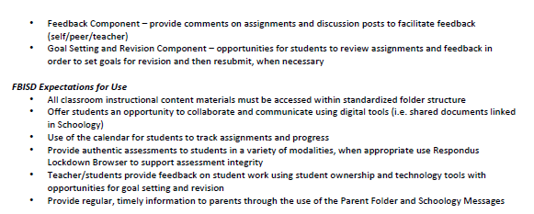
Instructional Tools
Notes:
2 min
Say: Schoology is our Learning Management System and is where teachers post lessons and assignments for students and give feedback. It is where students will engage with each other through collaboration tools and where students will submit their assignments.
-In an effort to improve the instructional experience for students, there are standardized folder structures and frameworks within Schoology this year.
-Additionally, students will see the Respondus LockDown Browser when they are required to take secure assessments inside Schoology. This is a new tool to secure online tests. Students will be locked out of visiting other programs or sites on their computer while taking an assessment.
-FBISD now has FBISD 1Link which will support improved access through a single sign-on and can provide data analytics to teachers on student engagement with the learning.

Slide 22
Instructional Tools
Notes:
2 min
Say: Microsoft Teams will be used for live, real time, synchronous instruction via videoconference with teachers and students. And it will be utilized with small group instruction.
In Teams, the teacher and students can share documents, files and links to assist students with collaboration. It is a more secure environment for collaboration and engagement that integrates with Microsoft Office 365.

Slide 23
The Back to School Readiness Form will be used to determine student need and assign devices. FBISD will transition device distribution to a campus-based model offering student pickup at their assigned campus.
Technology Distribution
Phase I
August 5 -14
Phase 2
August 17 -28
Notes:
Time: 1 min​​
​Say: Share information on the slide. Be sure to emphasize the dates for Phase 1 and Phase 2.

Slide 24
Support Resources
Notes:
Say: Now we will share the support resources.

Slide 25
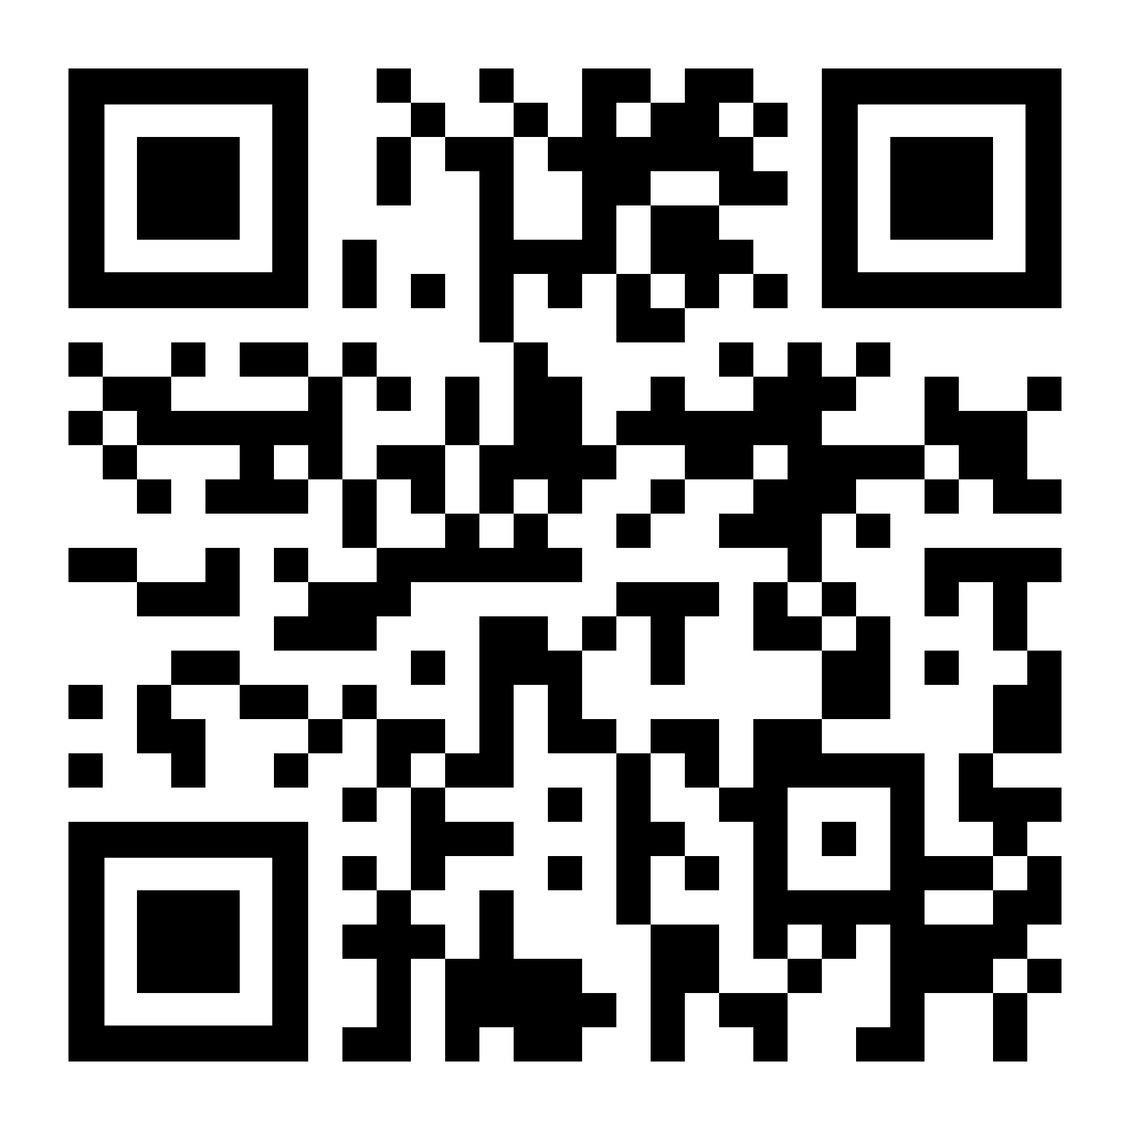
Student At-Home Learning
Online Support Options
Fort Bend ISD At-Home Learning resources have been curated to encourage creativity and enrichment as staff prepare to launch online learning. These activities and resources are designed to support students while school operations are impacted by the current response to COVID 19:
circumstances.
Notes:
Time: 2 min
Say: As we continue to explore, one the biggest questions you may have is about supporting your child in Grade Level Learning. The Student At-Home Learning site provides optional opportunities for enrichment in core academics, electives, and special programs like English Language Learning. The supports are grouped by Elementary, Middle, and High School. Let’s look at the supports that are provided and how to access the them.
Access the district website using the QR code
If a parent is unable to use the QR code, copy/paste the link below to the Chat box.
https://www.fortbendisd.com/Page/123380

Slide 26
Online Support Options—ES
Notes:
Time: 2 min​​
Presenter: ************Hide this slide if you are a middle or high school campus***********
Say: Let’s take a closer look and navigate to the resources available on the Fort Bend website.
If you select the blue Elementary Resource button, you will be taken to a new page with an array of grade level icon options.
Select the desired grade level button.
A PDF document will then appear on the screen. Remember, use this document as an additional resource to supplement classroom instruction.
Presenter Note:
If a parent is unable to use the QR code, copy/paste the link below to the Chat box.
https://www.fortbendisd.com/Page/123380

Slide 27
Online Support Options—MS
Notes:
Time: 2 min​​
Presenter: ************Hide this slide if you are an elementary or high school campus************
​
Say: Let’s take a closer look and navigate to the resources available on the Fort Bend website.
If you select the purple Middle School Resource button, you will be taken to a new page with an array of content specific icons.
Select the desired content specific button.
A PDF document will then appear on the screen. Remember, use this document as an additional resource to supplement classroom instruction.
Presenter Note:
If a parent is unable to use the QR code, copy/paste the link below to the Chat box.
https://www.fortbendisd.com/Page/123380

Slide 28
Online Support Options--HS
Notes:
Time: 2 min​​
Presenter: ************Hide this slide if you are an elementary or middle school campus************
Say: Let’s take a closer look and navigate to the resources available on the Fort Bend website.
If you select the green High School Resource button, you will be taken to a new page with an array of content specific icons.
Select the desired content specific button.
A PDF document will then appear on the screen. Remember, use this document as an additional resource to supplement classroom instruction.
Presenter Note:
If a parent is unable to use the QR code, copy/paste the link below to the Chat box.
https://www.fortbendisd.com/Page/123380

Slide 29
Sample Resource Document
Notes:
Time: 3 min​​
Say: If you click on the social studies icon. A document with activities will open. There are two types of resources available in each course – Online or screen time resources (point out the icon) and Offline/no screen time resources (point out the icon). At the top right hand corner of the table, the icon shows the type of resources. Each resource in the Online or screen time resources section provides the name of the site and link, a description/directions/or explanation and the grade levels
Say: Scroll down the document and you will find the no screen time or technology activities. Notice that the icon in the top right corner changes from a computer mouse to a pencil to indicate an off-line activity. The table provides a description of the activity and the grade levels that are appropriate for the activity. Notice that anything written in blue is hyperlinked to an activity. When you clicked the blue title, you will be taken directly to the resource.

Slide 30
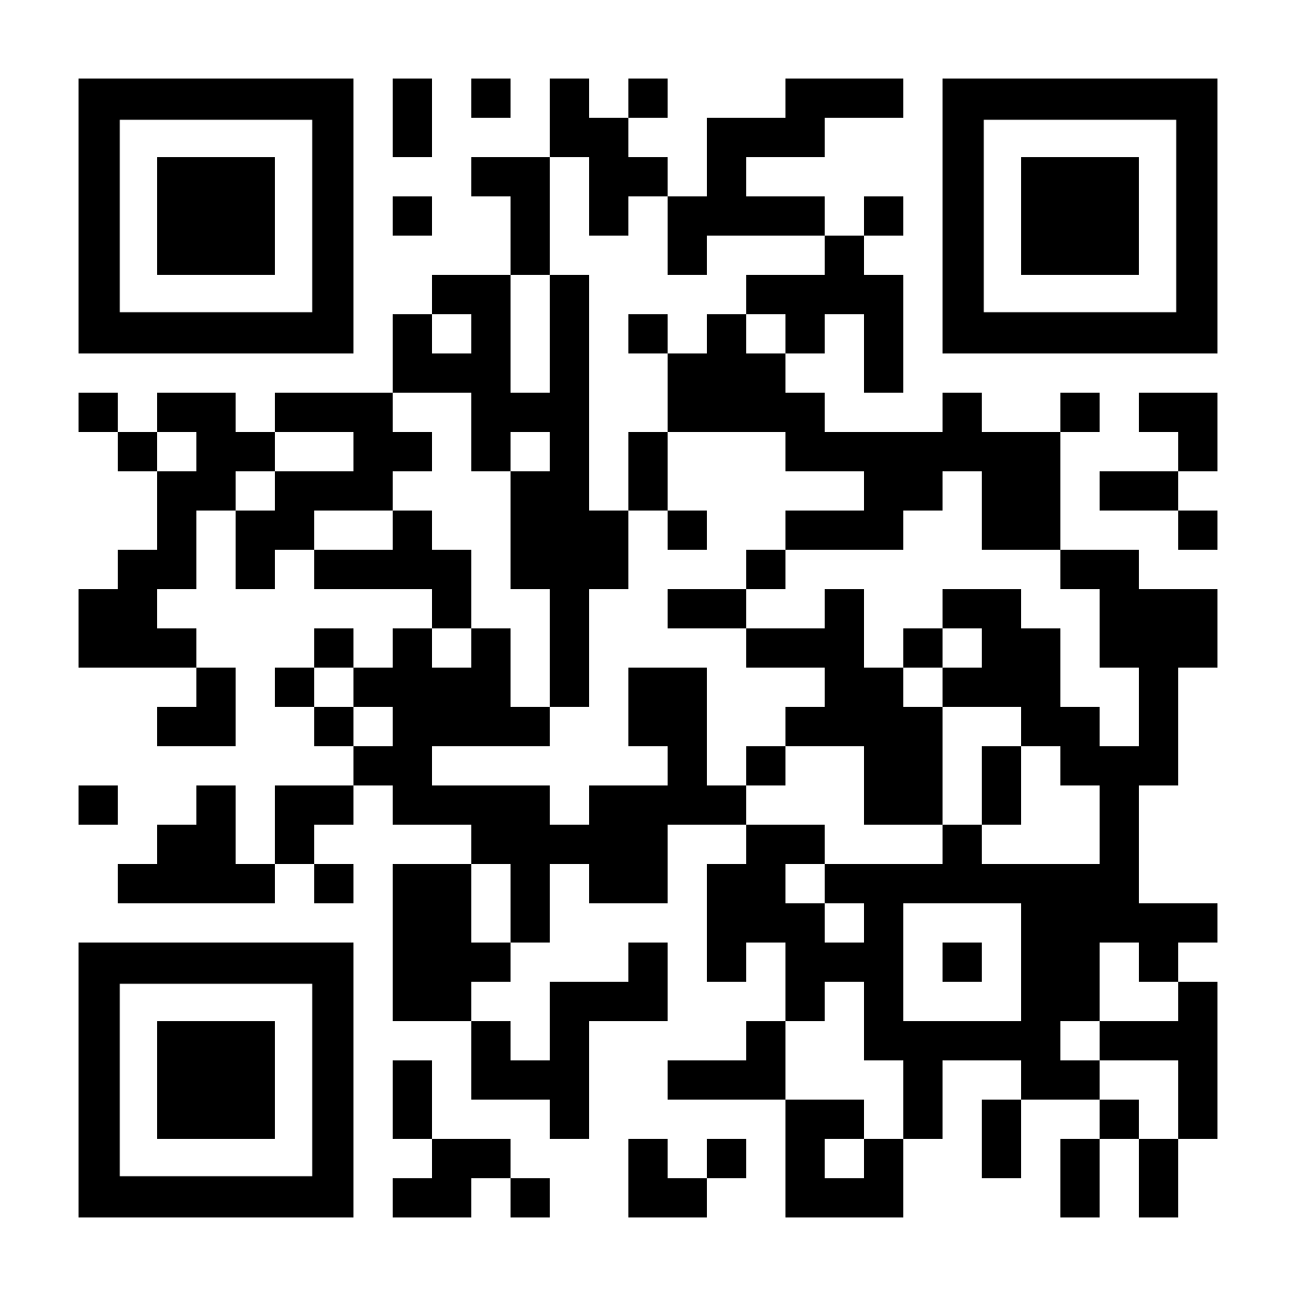
Parent and Student Supports
Visit www.fortbendisd.com/onlinelearningsupport for At-Home support resources available 24 hours a day, 7 days a week.​
Additional parent sessions:
Instructional expectations
Technical training
Notes:
Time: 2 min​​
​​
​Say: Share information on the slide and explain that parents can visit the website.
If a parent is unable to use the QR code, copy/paste the link below to the Chat box.
Online Learning Support: https://www.fortbendisd.com/onlinelearningsupport

Slide 31
How prepared do you feel for the start of online instruction at the start of school, August 17?
Excited
Unsure
Concerned
1
2
3
Notes:
Time: 2 min​
Say: Now that we’ve concluded the session, I’d like to revisit our emoji’s from the beginning, I’d like to see if any your minds have shifted yet after hearing today’s presentation. Do you feel more comfortable and excited about the launch of the school year, are use still unsure or are you concerned. Please take a moment to indicate which one represents you the most now. Just simply type in the number in the chat box.
Do: Presenter is to monitor the chat to get a sense of how parents are feeling, if there is a change from the second slide mention it.

Slide 32
Q & A Session
Notes:
Time: 5 min
Say: Now we'd like to hear what questions you have for us. Please type your questions in the chat box or unmute your mic to speak.
Note: We encourage you to adhere to the topics in the presentation; be sure to use the script as you reply to parent questions.
If a parent has a question or concern, not aligned with the agenda topics, please respond using the following statement:
Say: In an effort to share current information, I’m prepared to support you on the content presented tonight. I may not have information beyond what’s presented. Thank you.

