Slide 1
Welcome to Intro to Java!

Slide 2
Intros
Let’s get started!

Slide 3
Intro
Is this your first coding class?
Icebreakers:
Name, school district, one fun thing you’re looking forward to this summer
Why do you want to code?

Slide 4
Rules
Listen to the teachers
Respect other classmates, teachers, and the room
Raise your hand to answer a question
Stay on task - Don’t go to other websites or programs
If you need to get up or leave the room, notify a teacher
One at a time for restroom use, one of the teachers will walk you there
Have fun!!

Slide 5
What is coding?
Coding is what makes it possible for us to create computer software, apps and websites. Your browser, your OS, the apps on your phone, Facebook, and this website – they’re all made with code.
Coding is the process of using a programming language to get a computer to behave how you want it to. Every line of code tells the computer to do something, and a document full of lines of code is called a script.

Slide 6
Why is it important?
Coding allows everything computer-related to run: programs, software, the Internet, phone apps, etc.
Coding is a valuable skill that can lead to a high-paying job.

Slide 7
How does it work?
The programmer writes up a script, a document with lines of code, that the computer follows line-by-line.
It uses a program called a compiler to convert the code on the script to a language the computer can understand.
The computer uses the script as instructions to follow (series of steps for the computer to carry out).

Slide 8
What is Java?
First released in 1995 and has now become one of the most popular programming languages in the world!
Open-source & free -- Anyone can download and use it!
Java code is easy to read.
Primarily used in the real world for web and app development
Did you know Minecraft was created using Java?

Slide 9
Where is Java used?
Minecraft
Google
Netflix
Spotify
LinkedIn
Uber
Amazon
And more!

Slide 10
Section 1a: Foundations of Java
Let’s get started!

Slide 11
“Hello world”
When programmers learn a new language, they start by printing ‘Hello, world!’ to the console.
Code:
System.out.println("Hello, world!");
Output:
Hello, world!
Congratulations! You just ran your first Java program!

Slide 12
What sets Java apart from other languages?
Simple syntax, with similarities to English
Syntax refers to the rules of the language
Semicolons complete a command
Commands can be written on multiple lines
;
Curly brackets indicate blocks of code
Defines scope of loops, functions, and classes
Important for the code’s structures and readability
{ }
For now, just pay attention to the brackets and the semicolons.
Semicolons show when one step ends and another step begins.
Curly brackets divide the code into sections.
Write your code within the brackets.

Slide 13
Variables
A variable is able to hold a value
Java needs explicit variable declaration
Variable type + Variable name + assignment operator (=) + variable value
Code:
String message = "Hello world!";
System.out.println(message);
Output:
Hello world!
The print statement is often used to output variables

Slide 14
Variables (continued)
When we first define a variable, it is called initialization
You can change the value of a variable at any point
Code:
String message = "Hello world!";
System.out.println(message);
message = "Java is my favorite language!";
System.out.println(message);
Output:
Hello World!
Java is my favorite language!

Slide 15
Naming rules
Variables can only contain letters, numbers, underscores, or $
May start with letters, underscores, or $, cannot start with numbers
Spaces are not allowed in variable names
Use underscores instead
Variable names should be descriptive without being too long
Be careful about using the lowercase letter l and the uppercase letter O in places where they could be confused with the numbers 1 and 0
Camelcase (variable names are case-sensitive)
age, Age, and AGE are considered three different variables

Slide 16
Exercises
Print your name, birthday, school you go to, and grade on one line each
Make sure you use variables!
Remember double quotes around the text!
To print a new line, use System.out.println().
Challenge: In the same program, change the variables’ values to your friend’s name, birthday, school, and grade. Print your info first, and then print your friend’s info.
Bonus Challenge: Print all the variables on one line

Slide 17
Note about Java
You’ll notice in your code there is a large amount of extra code
For now, don’t worry about it - we’ll learn more about it later. Just code between the curly brackets under “public static void main(String[] args)
public class Main
{
public static void main(String[] args)
{
System.out.println(message);
}
}

Slide 18
Section 1a: Foundation Questions
Define a variable!
Think of a good variable name for a variable that stores your name.
Why do you think we write ‘String’ in front of our variable name when instantiating?

Slide 19
Section 1b: Comments
Commenting code and good practices!

Slide 20
Comments
Used to clarify code and are not interpreted by Java
Start with the two slash characters ‘//’ and extend to the end of the physical line
Allow you to write in English within your program
Code:
// This line is a comment.
System.out.print("This line is not a comment, it is code.");
Output:
This line is not a comment, it is code.

Slide 21
Multi-Line Comments
Allows a comment to extend past 1 line
/* opens the comment and */ closes the comment.
Code:
/*
This line is a multi-line comment.
It can extend past one line.
*/
System.out.println("This line is not a comment, it is code.");
Output:
This line is not a comment, it is code.

Slide 22
What makes a good comment?
It is short and to the point, but a complete thought. Most comments should be written in complete sentences.
It explains your thinking, so that when you return to the code later you or others will understand how your overall approach to a problem
It explains particularly difficult sections of code in detail.

Slide 23
When should you write comments?
When you have to think about code before writing it.
When you are likely to forget later exactly how you were approaching a problem.
When there is more than one way to solve a problem.
When others are unlikely to anticipate your way of thinking about a problem.

Slide 24
Section 1b: Comments Questions
Review with variables with a kahoot!
Review comments with a kahoot!

Slide 25
Section 2: Intro to Programming
Creating Shapes!

Slide 26
Turtle
In Java, a library is a collection of pre-written code that you can easily add to your program
In Java, one library called turtle allows you to draw shapes!

Slide 27
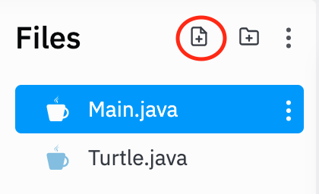
Setting Turtle Up
Before we can start using Turtle to draw lines and shapes, we need to copy and paste a custom class into our repl.
Click the “Add file” button, and name it Turtle.java.
Click the link below and copy-paste all of the code into your Turtle.java file.
Don’t worry about what it all means for now. All you need to know is that the code in your Turtle.java file allows everything else you type in the Main.java file to work.
https://docs.google.com/viewer?a=v&pid=sites&srcid=YXNtc2Eub3JnfGphdmEtdHVydGxlfGd4OjdlYzYyYjViZDdkNzRkZmI

Slide 28
Basics of Turtle
First we must create our turtle
By typing this line, we create our turtle
Turtle t = new Turtle();

Slide 29
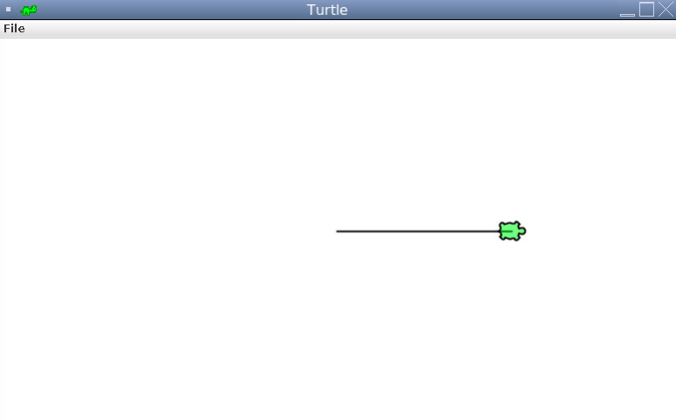
Moving the Turtle
Now add the line t.forward(100);
As you can see, the turtle moved to the right!
Now try changing the number in the parentheses! What happens? Why?

Slide 30
t.forward();
The line t.forward(); allows you to move the turtle in whichever direction the turtle is facing.
The number in the parentheses is the distance the turtle travels, so a larger number will let the turtle move farther and a smaller number lets the turtle move a shorter distance.

Slide 31
Changing the Direction
Now try adding two lines in your code:
What happens? Try replacing t.left(90) with t.right(90). What happens?
What do you think would happen if we replaced the number in the parentheses?
t.left(90);
t.forward(100);

Slide 32
Exercises
Try making a square! (Hint: you already made half of a square)
Try making an equilateral triangle (if you don’t know what that is, it’s a triangle whose sides have equal length)
Bonus challenge: try making a hexagon

Slide 33
Up and Down
What if you want to move but not draw a line?
t.up() tells the turtle to pick up its tail so it doesn’t draw on the screen
t.down() tells the turtle to put down its tail
t.forward(20);
t.up();
t.forward(20);
t.down();
t.forward(20);

Slide 34
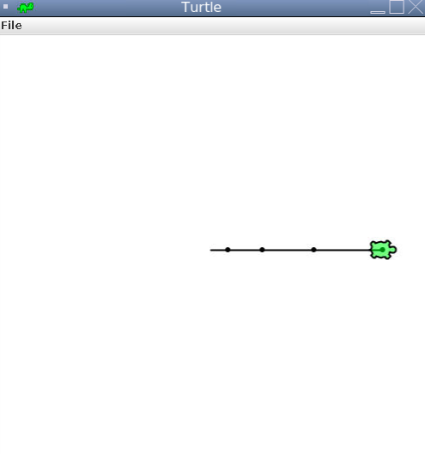
Dots
Regardless of whether your tail is up or down, you have the ability to leave a dot at your current position
To leave a dot, type t.dot()
bob.forward(20);
bob.dot();
bob.forward(40);
bob.dot();
bob.forward(60);
bob.dot();
bob.forward(80);
bob.dot();

Slide 35
Exercise
Make another square, but this time make each side dashed and drop a dot at each vertex.

Slide 36
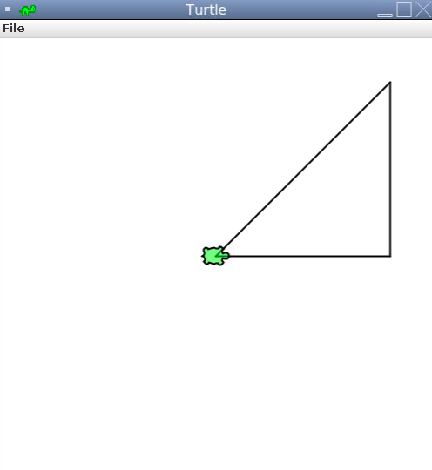
Reset
You can use t.home() to return the turtle to the center of the screen and pointed right.
Note: if the turtle’s tail is down it will draw a line as it goes home
t.forward(200);
t.left(90);
t.forward(200);
t.home();

Slide 37
Pen Color
t.penColor() allows us to change the color of what the turtle draws
To specify the color that we want to change the color of the pen to, just write the name of the color within the parentheses (e.g. t.penColor("red"))
Remember to have the color in quotation marks

Slide 38
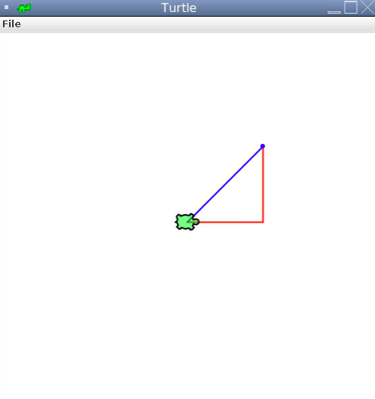
Pen Color
Which line changes the color to red? What about from red to blue?
Bonus question: why is the dot blue and not red?
Turtle t = new Turtle();
t.penColor(“red”);
t.forward(100);
t.left(90);
t.forward(100);
t.penColor(“blue”);
t.dot();
t.home();

Slide 39
Challenges
Make a star!
Try writing different letters!
Try drawing a house!
Use colors, dashes, and up and down to enhance your drawings!

Slide 40
Section 2: Turtle Questions
What is Turtle?
What are three things we can do with Turtle?
How can Turtle help us understand how all programming works?

Slide 41
Section 3: Data Types
Let’s explore data types and how to use them!

Slide 42
Data Types
A variable must be a specific data type
Primitive data types
byte, short, int, long, float, double, boolean, char
Non-primitive data types (Reference types - refers to an object)
Strings, Arrays, Classes, Interface, etc

Slide 43
Section 3a: Primitive Data Types
Understanding primitive data types and operators!

Slide 44
Boolean
Primitive data type
Stores ONLY true or false values
Declared with “boolean” keyword
Used for conditional testing (if ‘x’ is true, do ‘y.’)
Code:
boolean isThisClassSuperFun = true; //holds value of true
boolean areYouBored = false; //holds value of false

Slide 45
Characters (char)
Primitive data type
Stores ONLY a single character
EX: ‘a’, ‘1’, ‘D’, ‘ ‘
Declared with ‘’ (single quotes) around the value.
Code:
char x = ‘a’;
char y = ‘ ‘;

Slide 46
Numbers
6 numeric types in Java (all primitive)
byte
short
int
long
double
float
Code:
int x = 1; //int
double y = 2.8; //double

Slide 47
Numbers (continued)
Integer (int)
A whole number, positive or negative, without decimals, of limited length
Stores whole numbers from [-2,147,483,648] to [2,147,483,647]
Ex: 1, 35467, -94830
Double (double)
A number, positive or negative, containing a decimal point
Stores fractional numbers with up to 15 decimal digits
Can also be scientific numbers with an ‘e’ or ‘E’ to indicate powers of 10
Ex: 1.0, -35.59, 35e3

Slide 48
Operators
Operators are used to perform operations on variables and values
Divided into the following groups:
Arithmetic operators
Assignment operators
Comparison operators
Logical operators
Identity operators

Slide 49
Arithmetic operators
Used with numerical values to perform common mathematical operations
Addition - uses ‘+’:
Code:
System.out.println(3+2);
Output:
5
Subtraction - uses ‘-’:
Code:
System.out.println(3-2);
Output:
1
Multiplication - uses ‘*’:
Code:
System.out.println(3*2);
Output:
6

Slide 50
Integer operators
Modulus (remainder) - uses ‘%’:
Code:
System.out.println(3%2);
Output:
1
Exponentiation - uses a method:
Code:
System.out.println(Math.pow(3,2));
Output:
9

Slide 51
Exercise with Arithmetic Operators
Create 2 variables: 1 integer and 1 double.
Use the arithmetic operators you just learned to print the sum, product, and remainder of the integer and the double.
Sample Input/Output:
Integer = 30
Double = 5.4
Sum: 35.4
Product: 162.0
Remainder: 2.9999999999999982

Slide 52
Integer Division
Performs regular division, then throws away the remainder
7 / 2 = 3
Occurs when an integer is divided by an integer
Code:
int a = 5;
int b = 7;
System.out.println(b/a);
Output:
1

Slide 53
Decimal Division
Performs regular division, then keeps the remainder (as a decimal)
7 / 2 = 3.5
Occurs when either one (or both) of the operands is a double
Code:
int a = 5;
double b = 7.0;
System.out.println(b/a);
Output:
1.4
Code:
double a = 2.0;
double b = 9.0;
System.out.println(b/a);
Output:
4.5

Slide 54
Order of operations
Follows standard order of operations
Parentheses can be used to modify order of operations
Code:
int standardOrder = 2+3*4;
System.out.println(standardOrder);
Output:
14
Code:
int myOrder =(2+3)*4;
System.out.println(myOrder);
Output:
20

Slide 55
Assignment operators
Used to assign values to variables
Operator | Same As | Example
= | x = 5 | x = 5
+= | x = x + 3 | x += 3
-= | x = x - 3 | x -= 3
*= | x = x * 3 | x *= 3
/= | x = x / 3 | x /= 3
%= | x = x % 3 | x %= 3

Slide 56
Exercise with Assignment Operators
Create 1 integer.
Use the assignment operators you just learned to add 20 to the integer.
Print the integer.
Sample Input:
Integer: 3
Output:
23

Slide 57
Section 3a: Primitive Data Type Questions
Name 3 data types that we will use in Java!
What are the order of operations?
Name the types of operations we went over and define them!
What are the 6 numeric data types in java?
Review numbers with a kahoot!

Slide 58
Section 3b: Strings
The string data type and how we can use it!

Slide 59
Strings
A reference data type used for storing text
Stores a sequence of many different characters
Contained by double quotes, not single quotes
Code:
String myString = "This is a double-quoted string.";
System.out.println(myString);
Output:
This is a double-quoted string.

Slide 60
Concatenation
A plus sign combines two strings into one
Code:
String firstName = "Ada";
String lastName = "Lovelace";
String fullName = firstName + " " + lastName;
System.out.println(fullName);
Output:
Ada Lovelace

Slide 61
Concatenation (continued)
You can use as many plus signs as you want when composing messages
Code:
String firstName = "Ada";
String lastName = "Lovelace";
String fullName = firstName + " " + lastName;
String message = fullName + " " + "was considered the world's first computer programmer.";
System.out.println(message);
Output:
Ada Lovelace was considered the world's first computer programmer.

Slide 62
Concatenation (continued)
The + operator is used for both numbers and strings
Numbers are added, while strings are concatenated
Adding number and string results in string concatenation
Code:
String x = "10";
int y = 24;
System.out.println(x + y);
Output:
1024

Slide 63
Exercise with Concatenation
Stephen is at the supermarket, and he wants to know his total cost. He bought 5 pizzas, which cost $14.35 each. Print his total cost like the output shown below.
Sample Output:
Total Cost: $71.75

Slide 64
Indexing
Strings are a list of characters
Each character has its own index, which specifies the position of the character
In Java, when we are numbering (indexing) things we almost always start counting with 0. Keep this in mind for the future. This is called 0 indexing.
Example: “Hello, World!”
H
e
l
l
o
,
W
o
r
l
d
!
0
1
2
3
4
5
6
7
8
9
10
11
12

Slide 65
Substring
Code:
String b = "Hello, World!";
System.out.println(b.substring(2, 5));
Output:
llo
Note:
Position 5 is not included
A substring is a part of a string.
Strings are indexed starting at 0
Gets the characters from position 2 to position 4
The first argument is inclusive while the second is exclusive

Slide 66
Substring
Code:
String b = "Hello, World!";
System.out.println(b.substring(2, 5));
Output:
llo
H
e
l
l
o
,
W
o
r
l
d
!
0
1
2
3
4
5
6
7
8
9
10
11
12

Slide 67
Exercise with Substring
Create two strings: firstName and lastName.
Concatenate the first two letters of firstName and last two letters of lastName.
Print the result.
Sample Input:
First Name: Abraham
Last Name: Lincoln
Output:
Abln

Slide 68
Section 3b: String Questions
Define concatenation.
Review Strings with a kahoot!

Slide 69
Section 4: Input
Including user input in our code!

Slide 70
Command-line string input
Allows the ability to ask the user for an input
Allows the user to interact with the code
Uses a Scanner object -- built-in code for us to use!
Code:
Scanner sc = new Scanner(System.in);
System.out.println("Enter your name: ");
String x = sc.next();
// “sc” is referencing the name of the scanner
System.out.println("Hello, " + x)
Console:
Enter your name: James
Output:
Hello, James

Slide 71
Additional Command-line Inputs
String Inputs
next() only returns the first word, stops reading input at a whitespace
nextLine() returns the rest of the current line
Integer Inputs
nextInt()returns the integer input by the user
Double Inputs
nextDouble()returns the double input by the user
Note:
Since the name of the Scanner is “sc”, we type “sc.nextInt()”
If the name of our Scanner was “input”, we would type “input.nextInt()”
Our Scanner name can be almost anything!
Code (continuation of the code on the previous slide):
System.out.println("Enter your age: ");
int age = sc.nextInt();
System.out.println("Your age is " + age)
Console:
Enter your age: 13
Output:
Your age is 13.

Slide 72
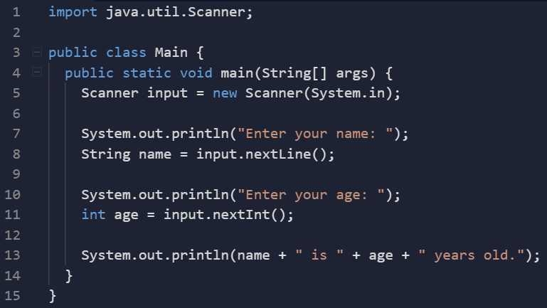
Command-line input syntax
1
1. Import Scanner: Since the software for the Scanner code has already been created, we just have to import the package to use the Scanner.
2. Creating a Scanner object: We created a Scanner called “input.”
3. Prompting the user: Once we have created the Scanner, we need to tell the user what they have to enter.
4. Storing the input: After the user types their input, we store it in a variable.
2
3
4

Slide 73
Exercise with Input
Have 3 variables: name, age and grade
Get input for each variable and then output all variables in one line.
Challenge: Make sure age is of type int and not String
Input:
What is your name: Claire Shao
What is your age: 16
What is your grade: 11th
Output:
Hello World! My name is Claire Shao and I am 16 years old. I am in 11th grade.

Slide 74
Exercise with Arithmetic
Input a number n.
Add 4 to some variable, n times, and then print
For example, if n = 4, you would do 4 + 4 + 4 + 4 = 16
Challenge: Use the assignment operators to assign your result to n, then print out n
Bonus: Output 4 to the power of n (Ex: if n = 3, 4^3 = 64)
Output:
Input: 5
Result: 20

Slide 75
Numbers Exercise
Daniel wants to create an addition-only calculator that takes 2 numbers from the user and adds them together. Help him code a program that can do this!
Challenge: Add together the absolute value of both numbers
Bonus: Print the difference as well.
Input:
Enter number 1: 4
Enter number 2: 5
Output:
9

Slide 76
Section 4: Input Questions
Briefly explain the steps to receive input
What is the difference between next()and nextLine()?

Slide 77
Section 5: Casting
How to change the data type!

Slide 78
Casting
Changing the data type of a variable (int, double, String)
Done when you need to specify a different data type on to a variable to use the functionalities on the new data type
Typecasting (between numerical types):
(int), (double)
Constructor functions (String to numerical type):
parseInt(String s)- constructs an integer number from an integer literal, a float literal (rounds down to the previous whole number), or a string literal (provided that the string represents a whole number)
parseDouble(String s)- constructs a float number from an integer literal, a float literal, or a string literal (provided the string represents a float or integer)

Slide 79
Casting Examples
Integer Casting:
Code:
int x = (int)2.8; // x will be 2
int y = Integer.parseInt("3");
// y will be 3
Double Casting:
Code:
double x = (double)3/2; // x will be 1.5
double y = Double.parseDouble("3"); // y will be 3.0
double w = Double.parseDouble("4.2");
// w will be 4.2
String Casting:
Code:
String x = "" + 1; // x will be "1"
String y = "" + 2.0; // y will be "2.0"

Slide 80
Casting Exercise
Ask the user to enter two integers: store one as an integer and another as a string.
Calculate and print the sum of the two numbers
Input:
Enter an integer: 21 // input stored as an integer
Enter another integer: 43 // input stored as a string
Output:
64 // notice how the input was NOT 2143

Slide 81
Section 5: Casting Questions
Define type-casting.
What is the result of casting the number 504.2343 into an integer?

Slide 82
Section 6: Conditionals
Using conditional statements to make decisions in our code!

Slide 83
Recall: Booleans
Primitive data type
Stores ONLY true or false values
Declared with “boolean” keyword
We use booleans to evaluate conditions.
Code:
boolean isThisClassSuperFun = true; //holds value of true
boolean areYouBored = false; //holds value of false

Slide 84
Conditions
Supports usual logical conditions from mathematics
Equals: a == b
Not equals: a != b
Less than: a < b
Less than or equal to: a <= b
Greater than: a > b
Greater than or equal to: a >= b
Most commonly used in “if statements” and loops
Note:
The single equal sign (=) is used to assign a value to a variable.
The double equal sign (==) is used to compare to values.
Code:
System.out.println(4 < 6); //outputs true

Slide 85
Comparison Operators
Used to compare two values
Operator | Name | Example
== | Equal | x == y
!= | Not equal | x != y
> | Greater than | x > y
< | Less than | x < y
>= | Greater than or equal to | x >= y
<= | Less than or equal to | x <= y

Slide 86
Identity Operators
Used to compare if objects (ex. Strings) have the same content
Operator | Description | Example
.equals() | Returns true if both variables are the same object | a.equals(b)
! .equals() | Returns true if both variables are not the same object | !a.equals(b)

Slide 87
Identity Operators (continued)
Instead of using ‘==’ to compare two strings, it is good practice to use .equals().
Code:
String a = "Java";
String b = "python";
String c = new String("Java");
//a and c have different memory locations
System.out.println(a == b);
System.out.println(a == c);
//compares memory location
Output:
false
false
Code:
String a = "Java";
String b = "python";
String c = new String("Java");
//a and c have different memory locations
System.out.println(a.equals(b));
System.out.println(a.equals(c));
//compares content
Output:
false
true

Slide 88
If-statement
Tests for a condition and then responds to the condition
If the condition is true, a block of code is executed
You can test for multiple conditions at the same time and respond to each condition appropriately
Written using the ‘if’ keyword
General structure of code:
if(condition){
//code to be executed
}
Note:
Remember your brackets, parentheses, and semicolons!

Slide 89
If-statement (continued)
Code:
int a = 33;
int b = 200;
if (b > a){
System.out.println("b is greater than a");
}
Output:
b is greater than a
a and b are used in the if statement to test whether b > a
Since 200 > 33, the if statement is satisfied, so we print “b is greater than a”

Slide 90
If-statement Exercise
Ask the user to enter 2 strings. If the strings are equal, print “You entered the same word!”
Sample Input:
Enter a word: comparisons
Enter another word: comparisons
Output:
You entered the same word!

Slide 91
Else
Catches anything which isn’t caught by the preceding if condition
Code:
int a = 200;
int b = 33;
if (b > a){
System.out.println("b is greater than a");
} else {
System.out.println("a is greater than b");
}
Output:
a is greater than b
The if condition is false, so we go to the else condition.

Slide 92
Else if
“If the previous conditions were not true, then try this condition”
Else if allows you to have additional conditions in between the if statement and the else statement.
Code:
int a = 200;
int b = 33;
if (b > a){
System.out.println("b is greater than a");
} else if (a == b){
System.out.println("a and b are equal");
} else {
System.out.println("a is greater than b");
}
Output:
a is greater than b
Note:
You can have as many else-if statements as you want.
a and b are equal, so the first condition is not true, but the else if condition is true

Slide 93
Breaking it down...
Is 33 greater than 200?
Condition 1
Code:
int a = 200;
int b = 33;
if (b > a){
System.out.println("b is greater than a");
} else if (a == b){
System.out.println("a and b are equal");
} else {
System.out.println("a is greater than b");
}
Output:
a is greater than b
Yes
True
False
No
Condition 2
b is greater than a
Is 33 equal to 200?
True
False
Yes
No
a and b are equal
a is greater than b

Slide 94
Conditional Exercise
Jen is having difficulty determining whether a number is a multiple of three. Write a code to help her out!
Input a number, and store into a variable “num”
If the number is a multiple of three, print “[num] is a multiple of three.”
If not, print “[num] is not a multiple of three.”
Output:
Input: 2324
Result: 2324 is not a multiple of three.
Input: 9
Result: 9 is a multiple of three.

Slide 95
&& (and)
‘and’ keyword
Logical operator used to combine conditional statements
Code:
if (a > b && c > a){
System.out.println("Both conditions are True");
}
Tests if a is greater than b AND if c is greater than a
Action only gets carried out if both conditions are met

Slide 96
|| (or)
‘or’ keyword
Logical operator used to combine conditional statements
Code:
if (a > b || a > c){
System.out.println("At least one of the conditions is True");
}
Tests if a is greater than b OR if a is greater than c
Only one condition needs to be met to carry out the following action

Slide 97
! (not)
‘not’ keyword
Logical operator flips boolean values (true becomes false, false becomes true)
Code:
if (!(a == b)){
System.out.println("a and b are not equal.");
}
Tests if a is equal to b
If ‘a == b’ evaluates to true, the ‘!’ flips the value to false, and nothing occurs.

Slide 98
Logical operators
Used to combine conditional statements
Operator | Description | Example
&& | Returns True only if both statements are true | x > 5 and x < 10
|| | Returns True as long as one of the two statements is true | x < 5 or x > 10
! | Reverse the result, returns False if the result is true | not(x < 5 and x > 10)

Slide 99
Conditional Exercise
Input a number, and store into a variable “num”
Use if statements and else if statements to determine if the number is greater than 10, less than 10, or equal to 10.
If it is less than 10, print “small.” If it is greater than 10, print “big.”
Challenge: Don’t use any brackets with your conditional statements
Output:
Input: 5
Result: small
Input: 200
Result: big

Slide 100
Section 6: Conditional Questions
Name the numerical logical operators in Java.
Explain the differences between an if statement, else if statement, and else statement!
Name the difference between && and ||.
How do we compare two strings?
Review with a kahoot!

Slide 101
Section 7: Loops
How to iterate through blocks of code!

Slide 102
Loops
Allows us to easily repeat a certain set of instructions however many times we want
Execute blocks of code as long as a specific condition remains true
Can save time, minimize errors, and allow for code to be more readable
Types of loops in Java
While
Do-while
For

Slide 103
While Loop
Allow for a set of statements to be executed as long as a condition remains true
General structure of code:
while (condition)
{
//code to be executed
}
Condition tests for a boolean expression (true or false) that must evaluate to “true” for the block of code to execute

Slide 104
While Loop (continued)
Code:
int i = 1;
while (i < 4){
System.out.println(i);
i+=1;
}
Output:
1
2
3
Note:
i is printed as long as i is less than 4
i must be incremented, or else the loop will run forever
While loop requires relevant variables to be ready
In this case, we need to define an indexing variable, ‘i’, which we set to 1

Slide 105
While Loop Syntax
1
int i = 1;
while (i < 4){
System.out.println(i);
i += 1;
}
1. The start value of the loop: We create a variable that begins our loop.
2. The condition: Every time the loop runs, it checks to make sure the condition is true. If the condition evaluates to false, the loop will stop.
3. The increment: To prevent our loop from running infinitely, we need to change the value of i every time the loop runs. Eventually, the condition will evaluate false and the loop will stop.
2
3
Note:
Remember to have your brackets and semicolons in the correct positions!

Slide 106
Breaking it down...
Start: Set i = 1
int i = 1;
while (i < 4){
System.out.println(i);
i += 1;
}
Output:
1
2
3
Condition
Is i less than 4?
Yes
True
False
No
Add 1 to i
End loop
Print i

Slide 107
While Loop Exercises
Use a while loop to print all the numbers from 23 to 102.
How many numbers are printed?
Hint: Increment your variable so that the loop doesn’t run forever!
Use a while loop to print every other number from 43 to 123.

Slide 108
Break Statement
Allows the ability to stop the loop even if the while condition is true
Code:
int i = 1;
while (i < 6){
System.out.println(i);
if (i == 3) {
break; }
i += 1; }
Output:
1
2
3
Note:
Loop is immediately terminated
Program resumes at next command following the loop

Slide 109
Breaking it down...
Code:
int i = 1;
while (i < 6){
System.out.println(i);
if (i == 3) {
break; }
i += 1; }
Output:
1
2
3
Start: Set i = 1
Condition
Is i less than 6?
Yes
True
False
No
Add 1 to i
Print i
No
False
Is i equal to 3?
True
Yes
End loop

Slide 110
Continue Statement
Allows the ability to stop the current iteration and continue with the next
Code:
int i = 1;
while (i < 4){
i += 1;
if (i == 3) {
continue; }
System.out.println(i);
}
Output:
2
4
Note:
The continue statement results in 3 being missing from the result

Slide 111
Breaking it down...
Code:
int i = 1;
while (i < 4){
i += 1;
if (i == 3) {
continue; }
System.out.println(i);
}
Output:
2
4
Start: Set i = 1
Condition
Is i less than 4?
Yes
True
False
No
Print i
Add 1 to i
False
Is i equal to 3?
True
Yes
End loop
No

Slide 112
Exercises with Continue Statement
Write a Java program that prints all the numbers from 0 to 6 except 3 and 6.
Challenge: Get a number n from the user and print all numbers 0 to n except any multiples of 3
Bonus: Allow the user to enter a start number, an end number, number to increment by, and what multiple not to include
Ex: Start=4, End=10, increment=2, multiple=3
Output: 4, 8, 10

Slide 113
For Loop
Used for iterating when you have a set number of iterations
Break and continue statement function in the same manner
Note:
Statement 1
Executed one time before the code block is executed
Initialization (start of for loop)
Statement 2
Outlines the condition to be tested
Statement 3
Executed every iteration after the code block is executed
General structure of code:
for (statement 1; statement 2; statement 3){
//code to be executed
}

Slide 114
For Loop
Code:
for(int i = 0; i < 5; i++){
System.out.println(i);
}
Output:
0
1
2
3
4
Code:
for(int i = 1; i < 6; i++) {
if (i % 2 == 0) {
continue; }
System.out.println(i); }
Output:
1
3
5
Note:
Less like the ‘for’ keyword in C-like languages, acts more as an iterator

Slide 115
Comparison: While Loop v. For Loop
Code: While Loop
int i = 0;
while (i < 5){
System.out.println(i);
i += 1;
}
Output:
0
1
2
3
4
Code: For Loop
for(int i = 0; i < 5; i++){
System.out.println(i);
}
Output:
0
1
2
3
4
Note:
Blue: start value
Red: Condition
Purple: Changes start value
Notice the similarities between the while loop and the for loop!

Slide 116
For Loop Exercises
Olivia wants to use a for loop to find the sum of the numbers from 1 to 10 (inclusive), but she is new to coding and is having trouble coming up with the program. Help her write it!
Challenge: Instead of having the sum stop at 10, ask the user for the end number. Find the sum of all the numbers from 1 to the end number.
Challenge Sample Input:
Enter an end number: 21
Output:
The sum is 231.

Slide 117
Do-While Loop
Variant of the while loop
Loop will execute code once before checking for condition, even if false
General structure of code:
do
{
//code to be executed
}
while (condition);
Loop will always be executed at least once
Afterwards, repeats loop as long as the condition is true

Slide 118
Do-While Loop (continued)
Code:
int i = 0;
do {
System.out.println(i);
i+=1;
} while (i < 5);
Output:
0
1
2
3
4
Note:
The ‘do’ keyword allows the loop to iterate at least once
i is printed as long as i is less than 5
i must be incremented, or else the loop will run forever

Slide 119
Breaking it down...
Start: Set i = 0
Code:
int i = 0;
do {
System.out.println(i);
i+=1;
} while (i < 5);
Output:
0
1
2
3
4
Print i, Add 1 to i
Condition
Is i less than 5?
Yes
True
False
No
Add 1 to i
End loop
Print i

Slide 120
Exercise with Loops
Input a number n
Loop n times, and print each value counting up to n
Output:
Input: 5
Result:
1
2
3
4
5
Challenge: Input a number x and a number n, print each value from x to n
Bonus: Create a function to accomplish either task
Try to create this loop with a for loop and then a while loop!

Slide 121
Nested Loops
Loop statement inside of another loop statement
General structure of code:
for (initialization; condition; increment)
{
for (initialization; condition; increment)
{
//statement inside inner loop
}
//statement inside outer loop
}

Slide 122
Nested Loops
For every iteration of the outside loop, the inside loop loops completely.
Code:
for (int i = 0; i < 2; i++){
System.out.println(i);
for (int j = 5; j < 7; j++){
System.out.println(j);
}
}
Output:
0
5
6
1
5
6
Code:
int sum = 0;
for(int i = 0; i < 4; i++){
for(int j = 0; j < 5; j++){
sum += 1;
}
}
System.out.println(sum);
Output:
20

Slide 123
Breaking it down...
Start: Set i = 1
Code:
int sum = 0;
for(int i = 0; i < 4; i++){
for(int j = 0; j < 5; j++){
sum += 1;
}
}
System.out.println(sum);
Output:
20
Condition 1
Is i less than 4?
Yes
True
False
No
Condition 2
Add 1 to i
Is j less than 5?
End loop
No
False
True
Yes
Add 1 to j
Add 1 to sum

Slide 124
Nested Loop Exercise
Scott wants to print a 10 by 10 multiplication table for himself using nested loops, and he needs your help writing a program that can do this. The output should be similar to the one shown below.
Output:
1 2 3 4 5 6 7 8 9 10
2 4 6 8 10 12 14 16 18 20
3 6 9 12 15 18 21 24 27 30
4 8 12 16 20 24 28 32 36 40
5 10 15 20 25 30 35 40 45 50
6 12 18 24 30 36 42 48 54 60
7 14 21 28 35 42 49 56 63 70
8 16 24 32 40 48 56 64 72 80
9 18 27 36 45 54 63 72 81 90
10 20 30 40 50 60 70 80 90 100

Slide 125
Section 7: Loop Questions
Name the 3 types of loops! Then explain what each are used best for!
What is a continue statement? What is a break statement?
What are nested loops?
Review with a kahoot!

Slide 126
Bonus Section 1: Advanced Strings
Let’s learn more about how we can manipulate strings!

Slide 127
Whitespace
Characters that the computer is aware of, but are invisible to readers
Spaces, tabs, and newlines
Spaces
Know how to create already
Tabs and newlines
Created by special character combinations

Slide 128
Tabs
Two character combination “\t” makes a tab appear in a string
Can be used anywhere within a string
Code:
System.out.println("Hello everyone!");
System.out.println("\tHello everyone!");
System.out.println("Hello \teveryone!");
Output:
Hello everyone!
Hello everyone!
Hello everyone!

Slide 129
Newline
Two character combination “\n” makes a newline appear in a string
Code:
System.out.println("Hello everyone!");
Output:
Hello everyone!
Code:
System.out.println("\nHello everyone!");
Output:
Hello everyone!

Slide 130
Newline (continued)
Code:
System.out.println("\n\n\nHello everyone!");
System.out.println("Hello\neveryone!");
Output:
Hello everyone!
Hello
everyone!

Slide 131
Stripping whitespace
Many times, users will be asked to input text
Very easy for users to include whitespace by mistake
Spaces, tabs, or newlines
Good idea to “strip” the whitespace from strings before you start working with them
Can strip from left side, right side, or both sides

Slide 132
Stripping whitespace (continued)
Code:
String name = " eric ";
System.out.println("-" + name.stripLeading() + "-");
System.out.println("-" + name.stripTrailing() + "-");
System.out.println("-" + name.strip() + "-");
Output:
-eric -
- eric-
-eric-

Slide 133
String Length
String in Java is an object
This means you can use methods to perform string operations
Length of string found with length() method
Code:
String text = "HELLOMYNAMEISCLAIRE";
System.out.println(text.length());
Output:
19

Slide 134
Changing case
Strings can change cases
Code:
String firstName = "eric";
System.out.println(firstName); // Prints "eric"
System.out.println(firstName.toUpperCase()); // Prints "ERIC"
firstName = "Eric";
System.out.println(firstName.toLowerCase()); // Prints "eric"

Slide 135
Changing case (continued)
Output:
eric
ERIC
eric

Slide 136
Substring
Code:
String b = "Hello, World!";
System.out.println(b.substring(2, 5));
Output:
llo
Note:
Position 5 is not included
Strings are indexed starting at 0
Gets the characters from position 2 to position 4
The first argument is inclusive while the second is exclusive

Slide 137
Finding a character in a String
Index represents position in a string
Returns the index of the first occurrence of the specified text
Code:
String message = "januaryfebruarymarch";
// 01234567
System.out.println(message.indexOf("february"));
Output:
7

Slide 138
Bonus Section 2: Doubles Exception
The case of the long decimal.

Slide 139
Special case - double
Sometimes will get an answer with an unexpectedly long decimal
Code:
System.out.println(0.1+0.2);
Output:
0.30000000000000004
Instead of working in powers of 10, computers work in powers of 2
No exact representation for ‘0.3’ in powers of 2
Can also get the same result with other types of operations

Slide 140
Bonus Section 3: Multidimensional Arrays
Arrays inside arrays!

Slide 141
Multidimensional Arrays
Multidimensional arrays are arrays within arrays.
For instance, an array inside an array creates a 2D array (rows and columns).
The code to above creates an array of 0’s with 5 rows and 3 columns.
Take note of the differences between making a 1D array and a 2D array.
Example:
int[][] nums = new int[5][3];

Slide 142
2D Arrays
If you know each element of the 2D array, you can create it like so:
What is the length of the second row?
Code:
int[][] nums = {{1, 2, 3},
{4, 5, 6, 7}};

Slide 143
Accessing an Element of a 2D Array
Code:
int[][] nums = {{1, 2, 3},
{4, 5, 6, 7}};
System.out.println(nums[1][2]);
Output:
6
[1] represents the row of the element.
[2] represents the column of the element.
Array indexes still start from 0!

