Slide 1
RANDOMNESS
Chapter 10

Slide 2
Random
An outcome is random if we know the possible values it can have, but not which particular value it takes.

Slide 3
Simulation
A simulation models a real-world situation by using random-digit outcomes to mimic the uncertainty of a response variable of interest

Slide 4
Simulation Component
A component uses equally likely random digits to model simple random occurrences whose outcomes may not be equally likely

Slide 5
Trial
The sequence of several components representing events that we are pretending will take place.

Slide 6
Response Variable
Values of the response variable record the results of each trial with respect to what we were interested.

Slide 7
randInt(1,6,2)

Slide 8
Sum(randInt(0,1,100)

Slide 9
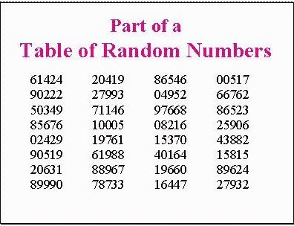
Random Number Table

Slide 10
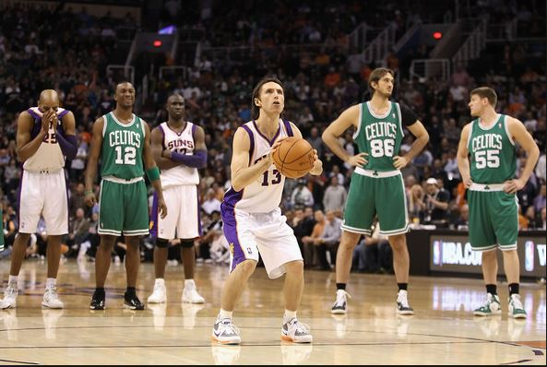

Slide 11
Simulation Steps
Identify the component to be repeated
Explain how you will model the component’s outcome
How do we combine the components to make a trial
State clearly what the response variable is
Run several trials
Collect and summarize results
State your conclusion

Slide 12
Problem:
For each time up at bat, a baseball player has a 70% chance of making an out, a 10% chance of getting walked, and a 20% chance of getting a hit. Estimate the probability that, out of 5 at-bats, the player gets at least one hit?

Slide 13
Problem:
A person with type O-positive blood can receive blood only from other type O donors. About 44% of the US population has type O blood. At a blood drive, how many potential donors do you expect to examine in order to get 3 units of type O blood.

