Slide 1
Estructuras para el Éxito para Padres de Familia
Notes:
Tiempo: 2 min
Introduction of Presenter(s):
Say: Welcome to the Structuring for Success webinar! My name is ______________ and I am here with ______________ from ______________ (name of school).
-We are excited to have you all here today as we share information to about FBISD expectations.
-Before we begin our session we’d like to go through some house keeping items.
-We ask that you please mute your mics as we go through our presentations today, just to avoid any feedback. To mute your mics, simply , locate the tool bar at the bottom of your screen and click on the icon that looks like a microphone, you will see a line go through the mic, this indicates it is muted.
-Please feel free to leave your cameras on or off, whatever you are more comfortable with. To turn your camera off or on, you will click on the camera located at the bottom of the screen.
-And finally, if at anytime you have a questions please put them in the chat box and the facilitator or myself will answer your questions the best that we can, we will also have time for Q&A at the end of our session so feel free to hold your questions to the end if you'd like. To type in the chat, located the tool bar at the bottom of your screen and click on the bubble that looks like it has text. Just to make sure everyone can use this feature, I’d like for you to please type a quick hello in the chat to ensure you are able to use this feature.
-Welcome again. Let's get started.

Slide 2
Dulles High School
Staff Name | Email | Phone number
Allison Pike - CAC | Allison.pike@fortbendisd.com | 2816345614
Kaitlyn Carpenter - Librarian | Kaitlyn.carpenter@fortbendisd.com | 2816345636
Kahley Warren - CCR | Kahley.warren@fortbendisd.com | 2816345820
Natalie Sylvester – ELL teacher | Natalie.Sylvester@fortbendisd.com | 2816342824
Emily Wilcox – counselor | Emily.wilcox@fortbendisd.com | 2816345424
Nicola Ballard – counselor | Nicola.ballard@fortbendisd.com | 2816345612
Martin Wall – teacher | Martin.wall@fortbendisd.com | 2816345656
Jordan Macha - teacher | Jordan.macha@fortbendisd.com | 2816342756
Notes:
Time: 3 min
Materials:
Strategy:
Presenter:
Please customize this slide, feel free to add more contact person or minimize contact person if there will only be one contact on your campus.
Introduce yourself, the campus name and contacts for parents to call in case of questions.

Slide 3
¿Qué tan preparado se siente para iniciar clases en línea cuando comience el ciclo escolar el 17 de agosto?
Emocionado
No estoy seguro
Preocupado
1
2
3
Notes:
Time: 2 min​
Say: Before we jump into all the learning for today, I’d like to take a quick poll and just get a temperature check on how everyone is feeling about your readiness for the launch of the 2020-2021 school year online. Please take a moment to look at these emoji's, which one represents you the most. Just simply type in the number in the chat box.
Do: Presenter is to monitor the chat to get a sense of how parents are feeling
Say: (Make a comment about what the majority of parents are feeling and validate their emotions especially if they are feeling concerned) We are hoping that by end of this session and any other parent session you participate in that we start to shift your mind to the excited Emoji. Y con eso podemos ver los objetivos de nuestra sesión.

Slide 4
Al final de esta sesión, usted podrá:
Objetivos de la sesión
Entender las expectativas del Distrito para los horarios de aprendizaje en línea de las escuelas primarias, secundarias y preparatorias.
Reconocer las horarios programados para el aprendizaje simultáneo y no simultáneo.
Emplear aplicaciones espaciales adecuadas para maximizar el aprendizaje de los alumnos desde su casa.
Utilizar los recursos de apoyo del Distrito para ayudar con el aprendizaje desde casa o en línea.
Conocer los servicios y el apoyo tecnológico que ofrece el Distrito.
Notes:
Time: 2 min​​
​
Lea los objetivos de la sesión a los padres.

Slide 5
Nuestra perspectiva
Conversación positiva
Planear
Alentar
Comunicación
Notes:
2 min​​
Digan: Al entrar en el nuevo ciclo escolar, tengamos en cuenta estos elementos clave para sentar las bases de un ciclo escolar exitoso.
Engage in positive talk and have a positive mindset. Research demonstrates that strong relationships between schools, families, and community members can positively affect student achievement and outcomes. Remember, your child is watching and learning from your every move and action, encourage a positive talk as much as possible.
Planning helps identify and ultimately achieve goals. When a team (like the parent and child) work together to set goals, it allows everyone to be on the same page, working toward a common, shared purpose.
Encouragement and support sets the tone when learning new skills and concepts. It is important to acknowledge when your child is excelling and to positively reinforce their behavior while doing so. Remember, there are steps to the learning process, be sure to celebrate their success along the way.
Communication is a key element with parent involvement. Be sure to contact your child's teacher and utilize all available resources from your child's campus and the District. We are here to support you!

Slide 6
Temas de la sesión
Horarios
Tecnología
Área de trabajo para los alumnos
Recursos de Apoyo
Notes:
Time: 2 min​​
​
Digan: Veamos brevemente los temas de nuestra sesión.
Today we will discuss:
Daily Schedules. This 2020-21 schedule will appear completely different from the schedule used in the Spring. The schedules are more structured and will permit time for synchronous and asynchronous instruction. Daily, synchronous learning will be the foundation of our instructional program. Teachers and students will have a full daily schedule of teaching and learning.
Student Work Space. The right workspace makes a huge difference in students’ mindset and ability to focus. When participating in e-learning, students have the ability to complete their work where they want, so it’s important to put thought into what kind of environment is truly most effective for them and make sure that they have a designated space at home.
Technology. Students and families will experience an improved online experience as we begin the new year with improvements with the learning experience delivery, the use of Schoology, and consistent progress monitoring and feedback. Additionally, we will review the Technology distribution plan for families in need of a device.
Support Resources. We will review the At-Home Learning resources available from the District website.
Let's begin!

Slide 7
Horarios
Notes:
Ahora haremos la transición a los horarios de los estudiantes

Slide 8
Asistencia diaria
A los alumnos de los grados 3º a 12º, se les pondrá presente diariamente cuando participen en las clases simultáneas/en vivo en línea en el horario designado diariamente.
Los alumnos en los grados PK a 2º se les pondrá presente cuando dediquen tiempo a las clases no simultáneas, lo que significa el progreso que mantengan a diario en nuestro Sistema de Gestión de Aprendizaje Schoology, y el progreso diario a través de las interacciones alumno-maestro, incluyendo el tiempo de clases simultáneo en el horario designado diariamente.
A todos los alumnos se les tomará asistencia diariamente en cada periodo de clase para que cuente para recibir créditos por la materia.
Se espera que todos los alumnos demuestren progreso a diario en el aprendizaje no simultáneo a través de Schoology, a través de:
Cumplir con los trabajos y tareas diarios,
Demostrar progreso académico, y
Comunicarse con el maestro en relación con los trabajos de la materia.
Notes:
2 min
Say: Attendance in the online environment will look differently than it did last spring. Teachers are required to record attendance daily.
-For students in grades 3-12, attendance is based on being engaged in the synchronous/live lessons daily at the designated time.
-For grades PK-2nd grade, students are marked present through asynchronous engagement daily.
-All students must make daily progress in their courses through synchronous and asynchronous learning and attendance will be taken daily in all courses to count toward course credit.
-FBISD utilizes Blackboard Connect to notify parents when students are marked absent.
-The Blackboard Connect system sends weekday daily attendance messages to parents for students who are marked absent.

Slide 9
Planeando el horario de su hijo
Paso 1
Revise las comunicaciones sobre las expectativas del grado a cursar por su niño en cada materia.
Paso 2
Tome en cuenta a los niños de su hogar, sus expectativas por grado, los dispositivos disponibles en el hogar y el apoyo necesario de los padres.
Paso 3
Planee un horario con tiempo para aprender el contenido a diario por cada uno de sus niños en el hogar, considerando las expectativas que le hayan comunicado. Considere el mejor lugar para que su niño haga sus trabajos.
Paso 4
Considere otros apoyos que su niño pueda necesitar, tales como ejercicio, descansos mentales, comidas, etc.
Notes:
Time: 2 min​​
​
Say: Cuando planifique la agenda diaria de su hijo, siga este proceso de 4 pasos:
Paso 1: Revise las comunicaciones sobre las expectativas del nivel de grado de su hijo para cada materia.
Paso 2: Considere a los niños de su hogar, sus expectativas de nivel de grado, los dispositivos disponibles en el hogar y el apoyo necesario de los padres.
Paso 3: Planifique un horario con tiempo para contenido diario para cada niño de su casa, considerando las expectativas que le comunicaron. Considere el mejor espacio para que su hijo haga su trabajo.
Paso 4: Considere otros apoyos que su hijo pueda necesitar, tal como ejercicio, descansos mentales, comidas, etc.

Slide 10
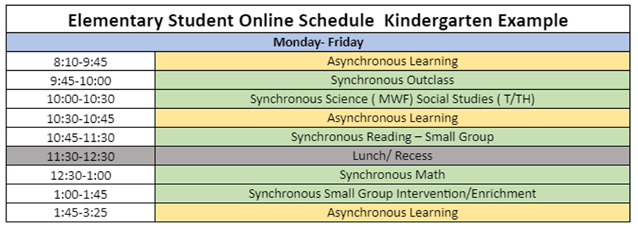
Plan Maestro de Aprendizaje en línea
Los alumnos de primaria recibirán el plan con el horario de su maestro a través de Schoology.
Notes:
Time: 2 min​​
​Presenter: ***********Hide this slide if you are an secondary campus************
Say: Now we will take a look at an Elementary student schedule. This is an example of a Kindergarten schedule. The first scheduled time of 8:10-9:45 is dedicated to asynchronous learning.
So for 1 hour and 35 minutes, students are participating in instruction that does not require having students and teachers engaged in learning at the same time. FBISD uses Schoology as the learning management system where asynchronous instruction is housed. This schedule highlights 3 asynchronous learning opportunities with varied times. The next time on the schedule is from 9:45-10:00 and is a synchronous outclass learning opportunity. Synchronous instruction is learning that happens "at the same time", exactly what you are doing here today with me. Through the online remote format, teachers will be able to engage with students in real time. The content "Outclass" refers to the enrichment classes such as art, music, computer and P.E.

Slide 11
Plan Maestro de Aprendizaje en línea
Horario de los alumnos de tercer grado de primaria con lectura en la mañana y matemáticas en la tarde.
Notes:
Time: 2 min​​
Presenter:​ ***********Hide this slide if you are a secondary campus************
​Say: Now we will take a look at another Elementary student schedule. This is an example of a 3rd Grade schedule. Students will also have asynchronous and synchronous learning opportunities with varied times. Like the kindergarten schedule, they will engage in content area, outclass, enrichment, intervention and small group learning opportunities. The 11:30-12:30 time slot is an opportunity for students to have a break, lunch and engage in an outdoor activity.

Slide 12
Plan Maestro de Aprendizaje en línea
Notes:
Time: 2 min​​
​Presenter: ************Hide this slide if you are an elementary campus************
Digan: Echemos un vistazo al horario de los alumnos de secundaria y preparatoria. This is an example of a Middle and High School online learning schedule. Like the Elementary schedule, students will be provided with asynchronous and synchronous learning opportunities with varied times. However, middle and high school students will have more synchronous learning opportunities with 30 minutes of asynchronous learning opportunities per week. The 12:30-1:30 time slot is an opportunity for students to have a break, lunch and engage in an outdoor activity.

Slide 13
Semana Típica de Escuela
Notes:
Time: 2 min​​
​
Say: Now that we have looked at some sample schedules for elementary and secondary students, let's take a look at what a typical school week looks like. For Pre-K, Kindergarten and 1st grade students there are a total of 1800 instructional minutes per week. 825 of those minutes is dedicated to synchronous instruction and 975 minutes are dedicated to asynchronous instruction. For 2nd – 5th grade there are a total of 1845 instructional minutes per week. 1025 of those minutes are dedicated to synchronous instruction and 820 minutes are dedicated to asynchronous instruction. Lastly, Secondary students have a total of 1805 instructional minutes. 1205 minutes of synchronous instruction, 280 minutes of asynchronous instruction and 320 minutes dedicated to mental health breaks and transitions.

Slide 14
Área de trabajo para los alumnos
Notes:
Di: Now we will transition to student workspace.

Slide 15
Creando un Espacio para el Aprendizaje en Línea
¿Hay un área en casa designada para el aprendizaje en línea?
ej.: el cuarto del niño, la mesa de la cocina, área cerca de la sala, un rinconcito que puede ser personalizado, etc.
¿Es un área con óptima conexión a internet?
¿Hay un pizarrón o pared vacía en la que pueda poner su horario, calendarios o trabajos que termine?
¿Hay libreros, canastas o recipientes que ayuden a mantener sus útiles escolares ordenados?
Preguntas a considerar:
Notes:
Time: 2 min​​
​Say: Let's now take a look at the student workspace and considerations for creating a space for online learning at home. Here are some questions for you to consider:
Is there an area designated at home for online instructional activities? i.e.: child’s room, kitchen table, small area off of the main living areas, a nook that can be personalized, etc.
Is the area optimal for internet connectivity?
Is there a bulletin board or empty wall space to post schedules, calendars, and completed work?
Are there bookshelves, baskets or bins to help keep supplies organized?

Slide 16
Crear costumbres diarias
Actividades sugeridas:
Piense en comenzar cada día escolar con una actividad inicial: como por ejemplo, un momento de silencio, una canción, un poema, una cita, el Juramento a la Bandera o revisar las actividades del día. Que sea una actividad corta y uniforme.
Limite las interrupciones externas: es decir, sin teléfonos celulares a menos que sea para tareas escolares, sin citas programadas o visitas en casa.
Incluya descansos regulares programados: Programe descansos de cinco a diez minutos dentro del horario de escuela. Este es el momento para que el niño se levante y se mueva, use el baño o coma algo. **La frecuencia y la duración de los descansos dependen de la edad del alumno y de los estilos de aprendizaje individuales.
Incluya a su hijo en las decisiones de planificación y programación: Déle a su hijo parte de la responsabilidad de determinar el horario basado en las tareas semanales que le de el maestro. Dele la opción de elegir cómo le gustaría completar sus tareas en base a sus intereses, gustos y estilos de aprendizaje. También pueden ayudar a limpiar su área al final del día, levantando sus cosas para que estén listos para el día siguiente.
(*Fuente: https://www.calverteducation.com/)
Notes:
Time: 4 min​​
​
Say: As students are learning at home, it may also be a good idea to create some daily rituals. Here is a list of suggested activities: 1) Think about beginning each school day with an opening activity: i.e.: a moment of silence, a song, a poem, a quote, the Pledge of Allegiance, or review of the day’s calendar activities. Manténgalo corto y uniforme. 2) Limit outside interruptions: i.e.: no cell phones unless for schoolwork, no scheduled appointments, or outside visitors. 3) Include regularly scheduled breaks: Schedule five to ten-minute breaks within the daily schedule. This is time for the child to get up and move around, use the bathroom, or get a snack. **The frequency and length of breaks depend on the age of the student and the individual learning styles. 4) Include your child in planning and scheduling decisions: Give your child some of the responsibility for determining the daily schedule based on weekly assignments provided by the teacher. Give them an option on how they would like to get assignments completed based on interests, likes and learning styles. They can also help cleaning up the area at the end of the day by putting materials away, so they are ready and available for the next day. You can read more about at-home learning at the website below: https://www.calverteducation.com/.

Slide 17
Tecnología
Notes:
Say: Now we will transition to Technology

Slide 18
Los alumnos y su familia tendrán una mejor experiencia en línea al comenzar el nuevo ciclo escolar. Incluyendo:
Experiencia de Aprendizaje en Línea Mejorada
Experiencia de Aprendizaje
Instrucción simultánea en vivo a través de herramientas de videoconferencia.
Herramientas tecnológicas racionalizadas para apoyar consistentemente la participación de los alumnos.
Experiencias diarias de aprendizaje no simultáneo.
Uso de Schoology
Organización mejorada de materias mediante una estructura de carpetas estandarizada.
Sistemas de comunicación estandarizados para los padres en Schoology.
Uso de calendario y boleta de calificaciones de Schoology para seguir el progreso.
Monitoreo y retroalimentación sobre el progreso
Evaluaciones formativas para comprobar el progreso diario de los alumnos.
Retroalimentación uniforme y continua.
Las calificaciones incluirán calificaciones numéricas o basadas en criterios.
Notes:
Time: 2 min​​
​​
Say: In the midst of the COVID-19 pandemic, Fort Bend ISD is reimagining education and how we work together to support our students and staff, in accordance with the District’s Mission, Vision and Core Beliefs and Commitments.
Improved online experience
Students and families will experience an improved online experience as we begin the year.
This will include:
Entrega de Experiencia de Aprendizaje
Instrucción sincrónica programada en vivo a través de herramientas de videoconferencia
Daily asynchronous learning experiences according to a defined schedule
Herramientas tecnológicas racionalizadas para apoyar la coherencia y el compromiso de los estudiantes
Uso de la Schoology
Improved course organization using a standardized folder structure within Schoology for ease of navigation and consistency for students and parents
Sistemas de comunicación estandarizados para los padres en Schoology
El uso del calendario y del boletín de calificaciones de Schoology para seguir el progreso
Monitoreo y feedback de Progreso
Formative assessments to check for daily student progress through interactive digital tools, student work submissions, and live interaction with teacher
Consistent and ongoing feedback within the Learning Management System, Schoology.
Grading practices will align to pre-COVID19 practices and include numerical or standards-based grades.
Transition to face-to-face instruction
When FBISD transitions to face-to-face instruction, the intention will be to have all students in daily face-to-face instruction, but planning does give priority to students in Prekindergarten to sixth grade and ninth grade.
Secondary students may participate in a rotation of both online and face-to-face instruction.
When students transition to face-to-face learning, participation in co- and extra-curricular activities will also become face-to-face, with proper safety guidelines in place.

Slide 19
Herramientas de Aprendizaje
Notes:
1 minuto
Say: As we start the 2020-21 school year, we are working to standardized the major instructional tools we use, so parents and students will know what tools to utilize and we can ensure consistency and quality across all courses.
We will briefly introduce the purpose of teach of the tools and then go more in depth with Schoology.

Slide 20
Herramientas de Aprendizaje
Notes:
2 min.
Say: Skyward is our student information system and includes schedules, the gradebook, the attendance record, discipline, etc.
Through Skyward, we are able to monitor progress as of official progress and grade reporting periods.
It houses the official gradebook, attendance and disciplinary records for students.

Slide 21
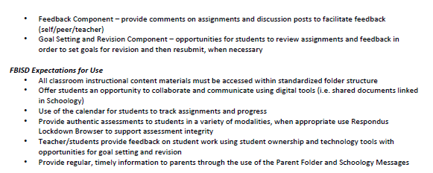
Herramientas de Aprendizaje
Notes:
2 min
Digan: Schoology es nuestro sistema de gestión del aprendizaje y es donde los maestros publican las clases y tareas para los alumnos y dan sus comentarios. Es donde los alumnos se relacionarán entre sí a través de herramientas de colaboración y donde los alumnos presentarán sus tareas.
-En un esfuerzo por mejorar la experiencia educativa de los alumnos, hay estructuras de carpetas estandarizadas y marcos dentro de Schoology este año.
-Además, los alumnos podrán ver el Respondus LockDown Browser cuando se les pida que tomen pruebas seguras dentro de Schoology. Esta es una nueva herramienta de seguridad para tomar pruebas en línea. Los alumnos no podrán visitar otros programas o sitios en su computadora mientras que toman una prueba.
-FBISD ahora cuenta con FBISD 1Link que apoyará un mejor acceso a través de un solo inicio de sesión y puede proporcionar análisis de datos a los profesores sobre la dedicación de los alumnos en el aprendizaje.

Slide 22
Herramientas de Aprendizaje
Notes:
2 min
Say: Microsoft Teams will be used for live, real time, synchronous instruction via videoconference with teachers and students. And it will be utilized with small group instruction.
Es un entorno más seguro para la colaboración y parfticipación que se integra con Microsoft Office 365.

Slide 23
El formulario de Preparación para el Regreso a Clases se usará para determinar la necesidad del alumno y asignar dispositivos. FBISD pasará a un modelo de distribución de dispositivos a través de las escuelas, para ofrecer a los alumnos la oportunidad de recogerlos en su escuela asignada.
Distribución de Tecnología
Fase I
Del 5 al 14 de agosto
Fase 2
Del 17 al 28 de agosto
Notes:
Time: 1 min​​
Be sure to emphasize the dates for Phase 1 and Phase 2.

Slide 24
Recursos de Apoyo
Notes:
Say: Now we will share the support resources.

Slide 25
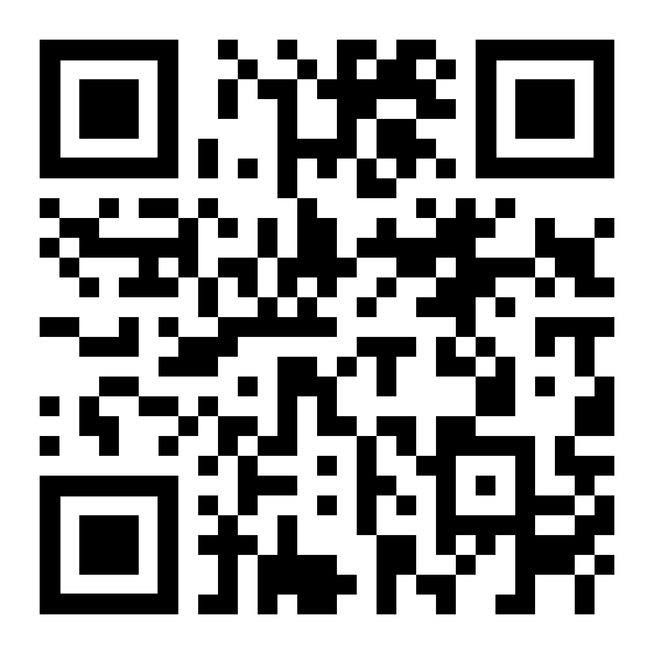
Aprendizaje desde Casa
Opciones de Apoyo en Línea
Los recursos para el Aprendizaje en Casa del Fort Bend ISD, se han diseñado para fomentar la creatividad y el enriquecimiento mientras que el personal se prepara para comenzar las clases en línea. Estas actividades y recursos están diseñados para apoyar a los alumnos mientras las operaciones de las escuelas se ven afectadas por la actual respuesta ante la Covid-19.
Notes:
Time: 2 min
Say: As we continue to explore, one the biggest questions you may have is about supporting your child in Grade Level Learning. The Student At-Home Learning site provides optional opportunities for enrichment in core academics, electives, and special programs like English Language Learning. The supports are grouped by Elementary, Middle, and High School. Let’s look at the supports that are provided and how to access the them.
Access the district website using the QR code
If a parent is unable to use the QR code, copy/paste the link below to the Chat box.

Slide 26
Opciones de Apoyo en Línea para todos los Niveles Escolares
Notes:
Time: 2 min​​
​
Say: Let’s take a closer look and navigate to the resources available on the Fort Bend site.
If you select the blue Elementary Resource button, an array of grade level icons will appear.
If you select the purple Middle School Resource button, an array of content specific icons will appear.
If a parent is unable to use the QR code, copy/paste the link below to the Chat box.

Slide 27
Opciones de Apoyo en Línea para Preparatoria
Notes:
Time: 2 min​​
Presenter: ************Hide this slide if you are an elementary campus************
Say: If the green High School Resources button is selected, an array of content specific option buttons will appear.
If a parent is unable to use the QR code, copy/paste the link below to the Chat box.

Slide 28
Ejemplo de Documento en los Recursos
Notes:
Time: 3 min​​
Say: If you click on the social studies icon. A document with activities will open. There are two types of resources available in each course – Online or screen time resources (point out the icon) and Offline/no screen time resources (point out the icon). At the top right hand corner of the table, the icon shows the type of resources. Each resource in the Online or screen time resources section provides the name of the site and link, a description/directions/or explanation and the grade levels
Say: Scroll down the document and you will find the no screen time or technology activities. Notice that the icon in the top right corner changes from a computer mouse to a pencil to indicate an off-line activity. The table provides a description of the activity and the grade levels that are appropriate for the activity. Notice that anything written in blue is hyperlinked to an activity. When you clicked the blue title, you will be taken directly to the resource.

Slide 29
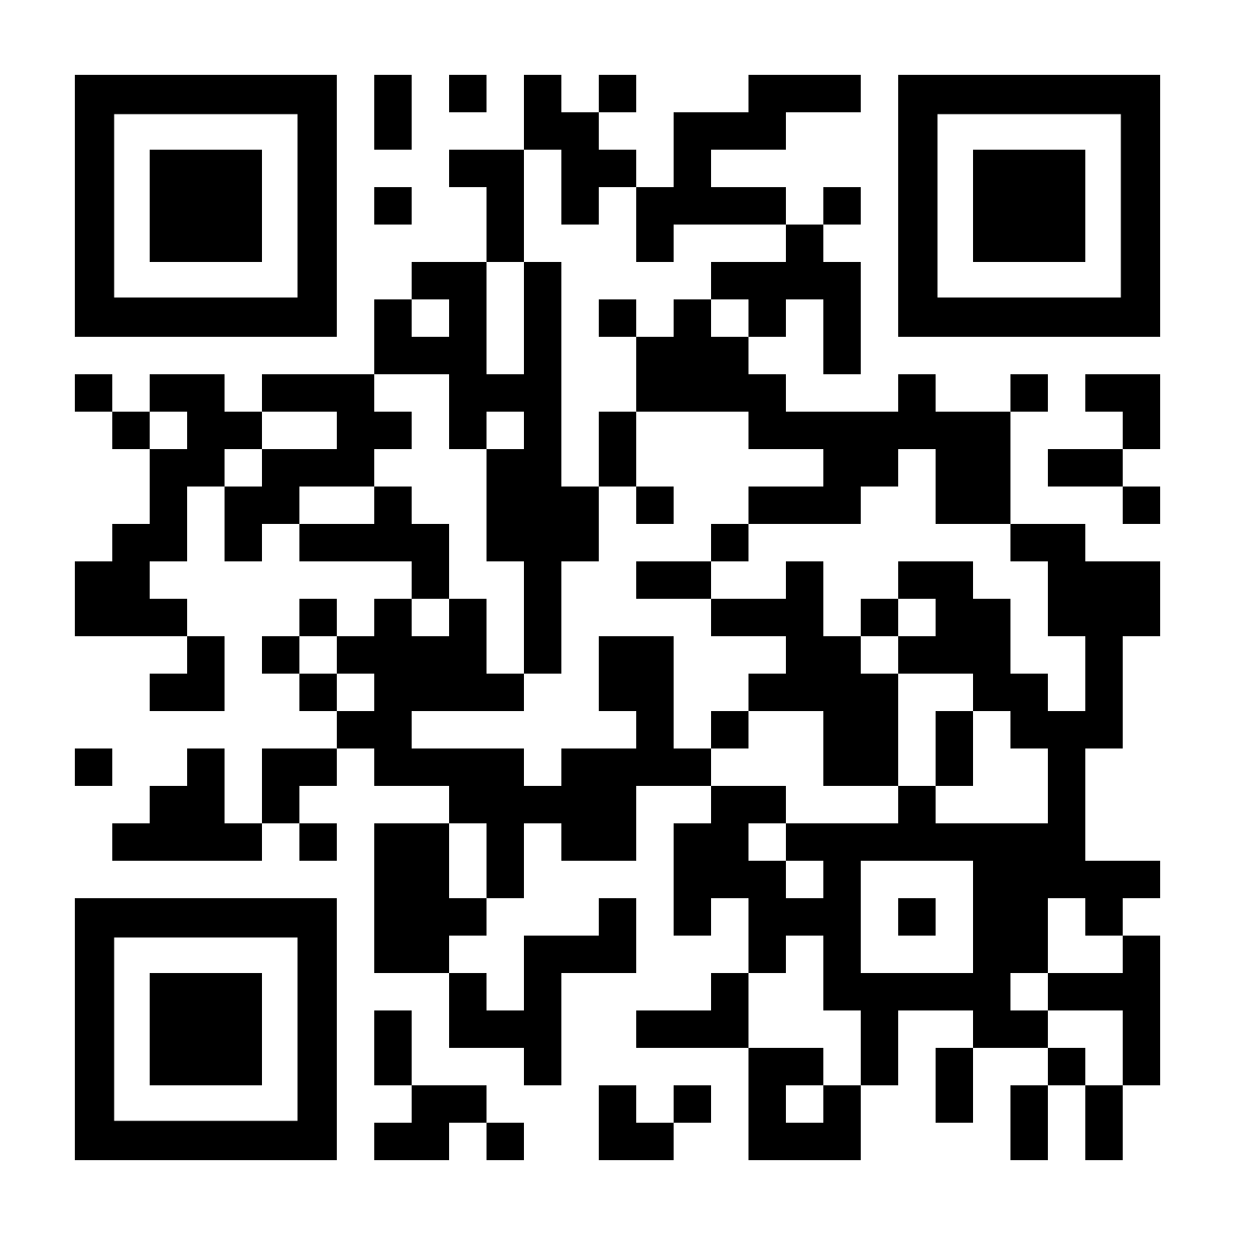
Ayuda a los Padres y Alumnos
Visite www.fortbendisd.com/onlinelearningsupport para tener acceso a recursos de ayuda para el aprendizaje en el hogar, disponibles las 24 horas del día, los 7 días de la semana.
Sesiones adicionales para padres de familia:
Expectativas de Instrucción
Capacitación Técnica
Notes:
Time: 2 min​​
​​
​Say: Share information on the slide and explain that parents can visit the website.
If a parent is unable to use the QR code, copy/paste the link below to the Chat box.
Online Learning Support: https://www.fortbendisd.com/onlinelearningsupport

Slide 30
¿Qué tan preparado se siente para iniciar clases en línea cuando comience el ciclo escolar, el 17 de agosto?
Emocionado
No estoy seguro
Preocupado
1
2
3
Notes:
Time: 2 min​
Say: Now that we’ve concluded the session, I’d like to revisit our emoji’s from the beginning, I’d like to see if any your minds have shifted yet after hearing today’s presentation. Do you feel more comfortable and excited about the launch of the school year, are use still unsure or are you concerned. Please take a moment to indicate which one represents you the most now. Just simply type in the number in the chat box.
Do: Presenter is to monitor the chat to get a sense of how parents are feeling, if there is a change from the second slide mention it.

Slide 31
Sesión de Preguntas y Respuestas
Notes:
Time: 5 min
Say: Now we'd like to hear what questions you have for us. Please type your questions in the chat box or unmute your mic to speak.

